Slide 1


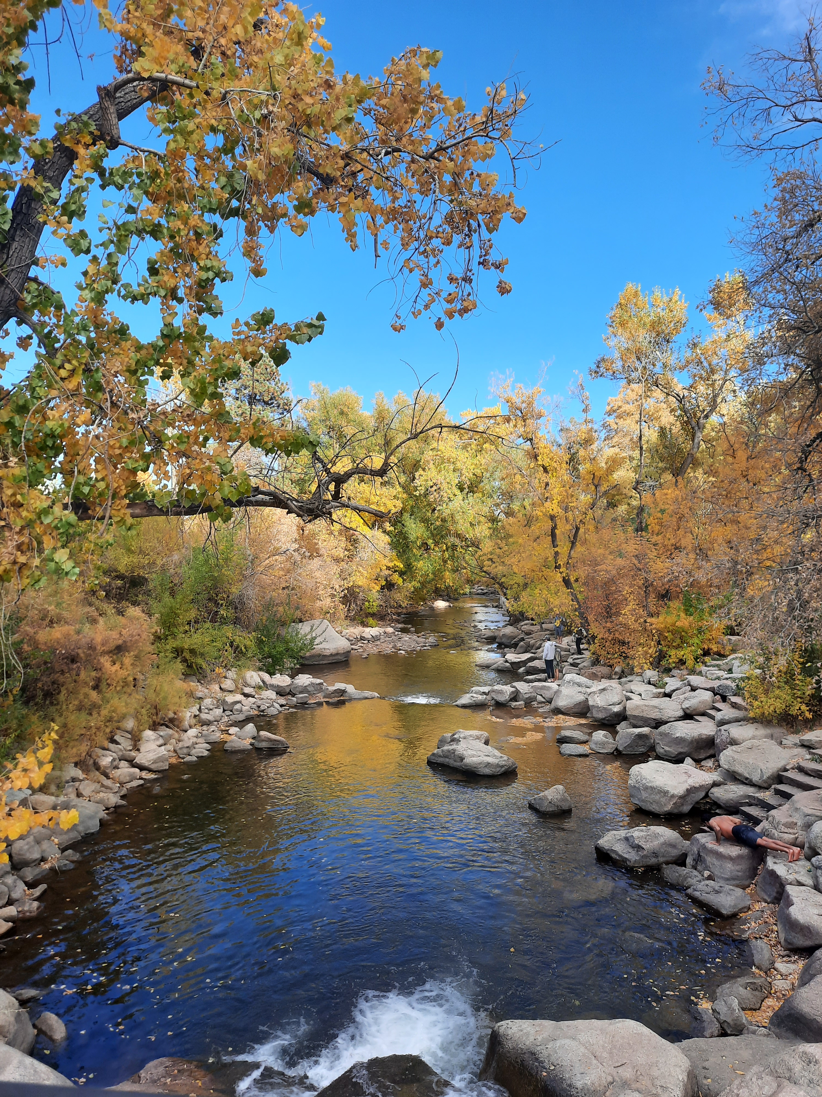


Rivers & Rocks
Integrating Channel Adjustments, Gravel Attrition, and Bedrock Wear in a Model of Long-Profile Evolution
Vanessa Gabel^{1, 2} and Greg Tucker^{1, 2}
¹Cooperative Institute for Research in Environmental Sciences
²Department of Geological Sciences, University of Colorado, Boulder
12 Dec 2022

Slide 2
Big take-aways:
Some “threshold rivers” incise bedrock!
Upstream rock properties affect downstream sediment load and fluvial behavior!
Observations & theory
Model development
Model behavior
Future applications

Slide 3
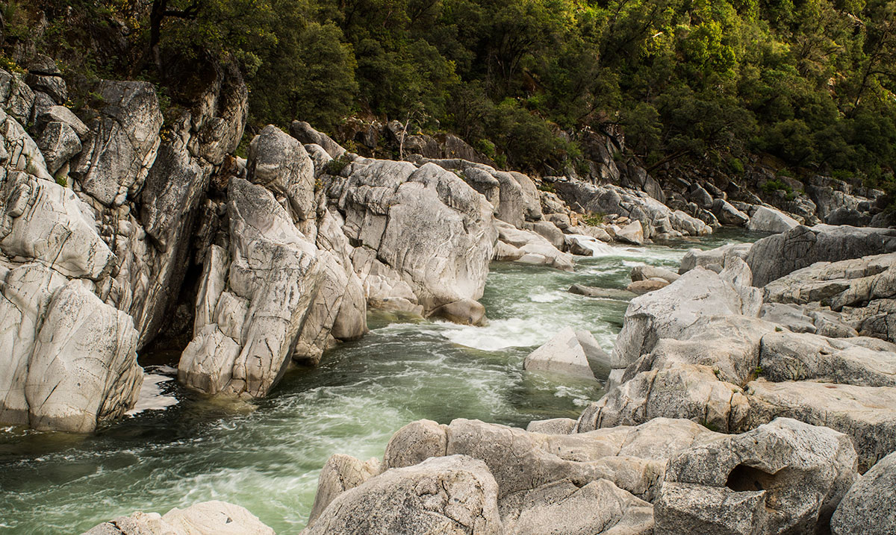
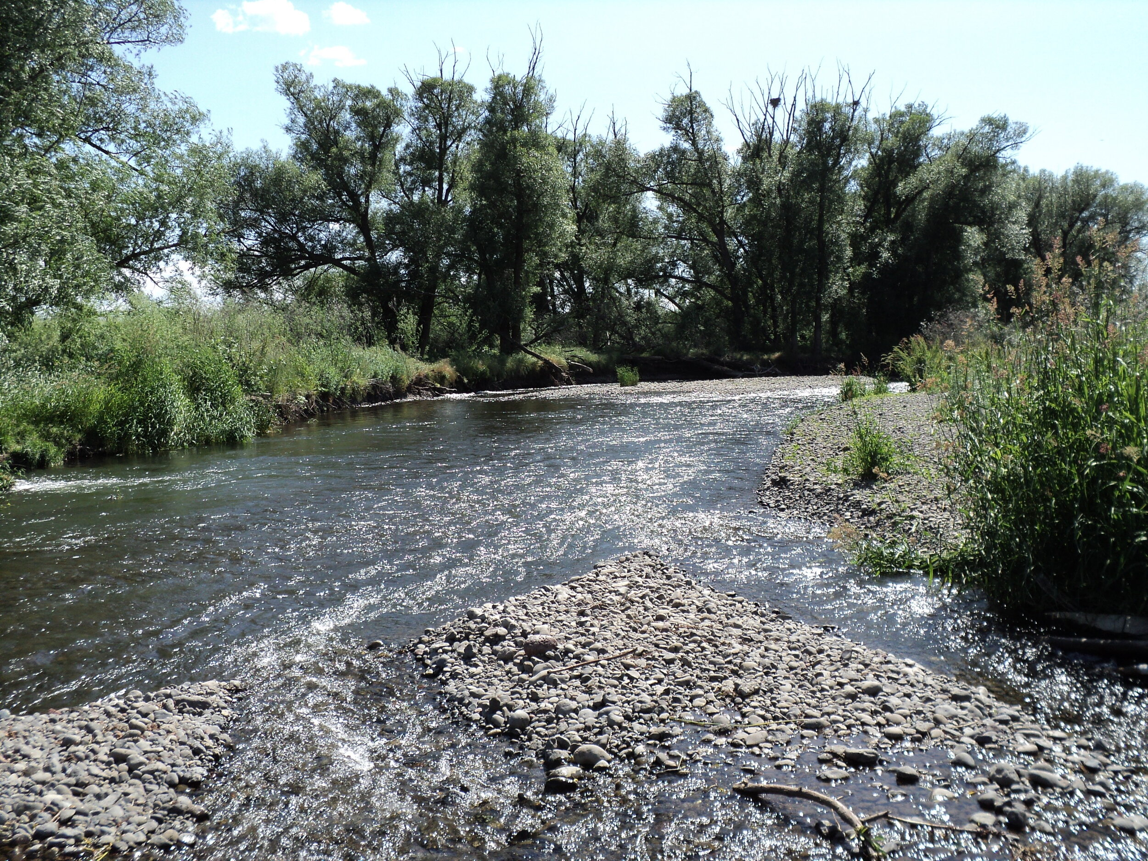
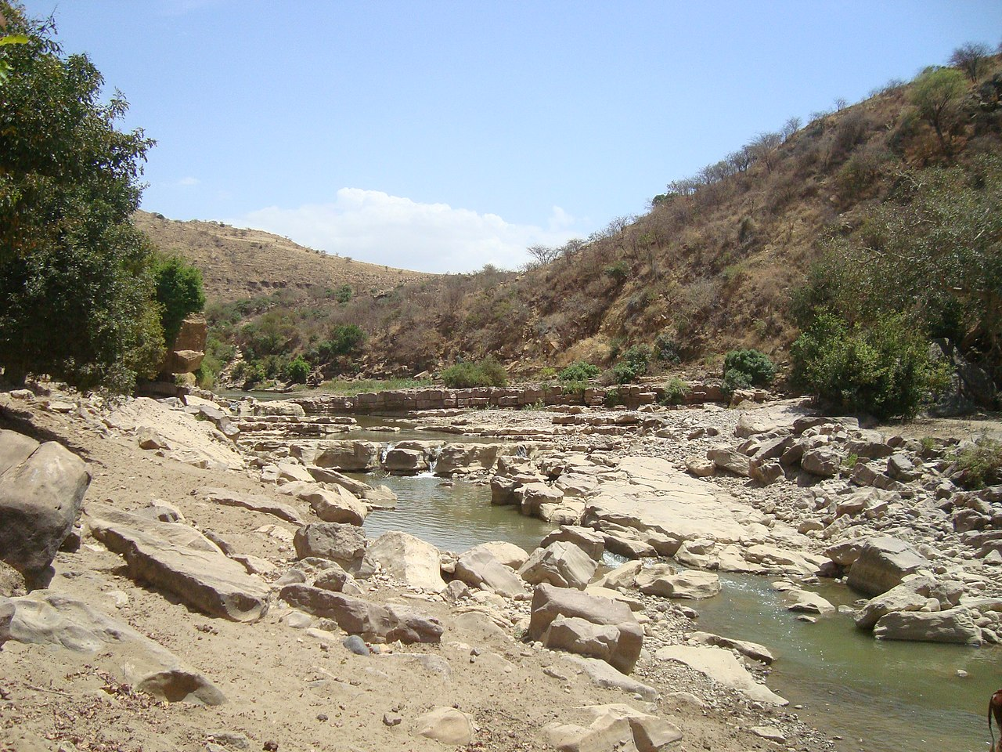
Bedrock Channels
Alluvial Channels
Mixed Channels
Width is confined
Detachment-limited, incise bedrock
Slope scales with bedrock properties and discharge
Sediment is exported rapidly; often neglected
“Threshold channels” → width is self-adjusted
Transport-limited
Slope graded to sediment transport
Selective transport and attrition
Width is self-adjusted within fixed valley
Slope adjusted to bedrock incision and sediment transport
Erode bedrock over long timescales, episodically alluviated
South Yuba River, Daniel Nylen
Mill Creek, The Science of Rivers
Giba River, Wikipedia

Slide 4
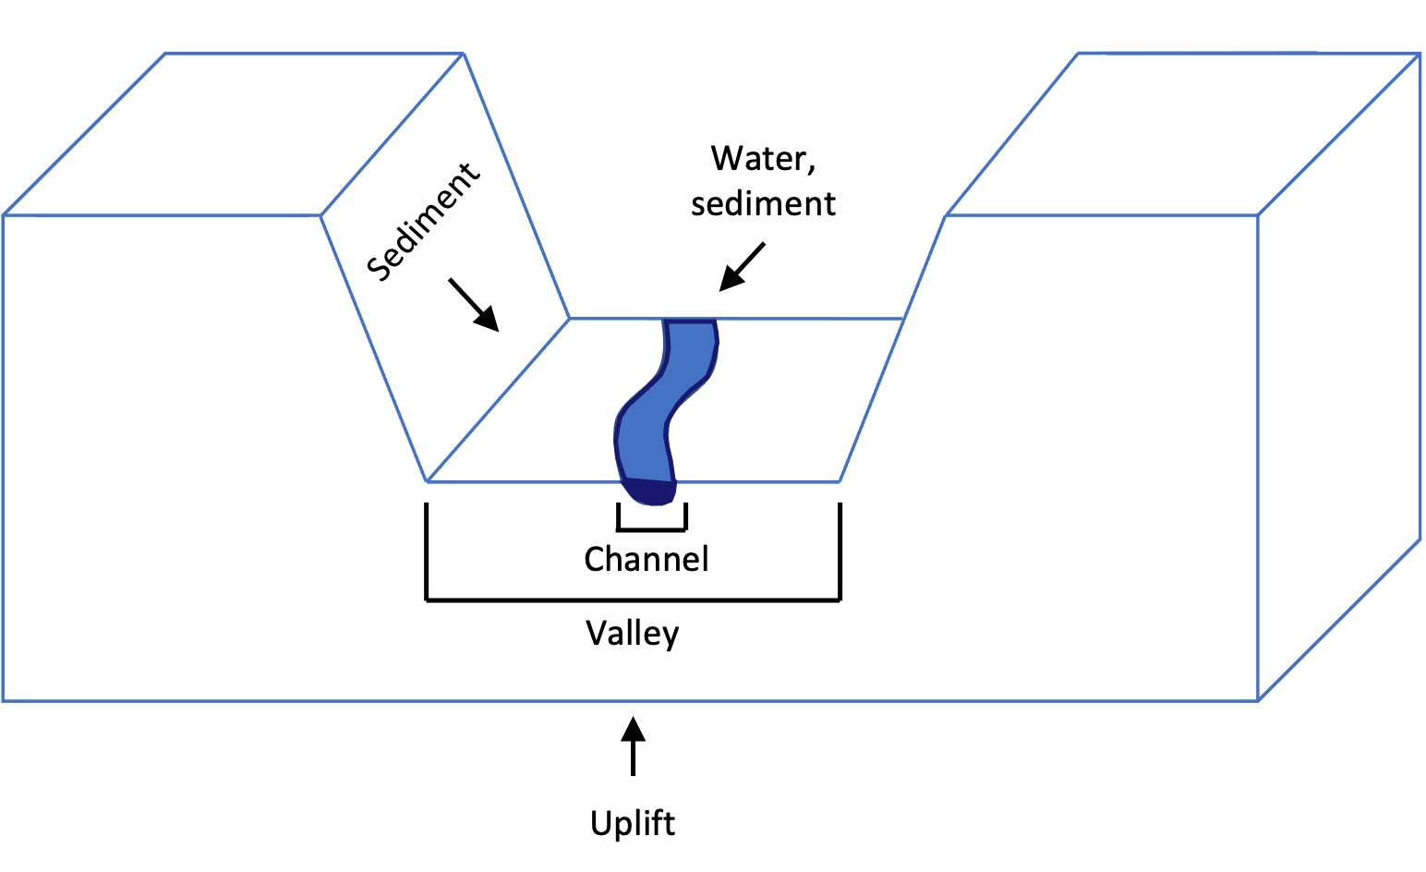
Our model builds upon previous efforts to capture the complexity of mixed bedrock-alluvial systems
Bedrock Components
Plucking via stream power
Alluvial Components
Near threshold channels, constant shear stress, self-adjusted width
Coarse sediment transport
Downstream fining
Modified from Wickert and Schildgen, 2019
Mixed Components
Abrasion
Process efficiency depends on sediment cover
Notes:
Bedload sediment transport in equilibrium channels
Channel width adjustment to flow and sediment characteristics
Abrasion of bedrock by mobile sediment
Plucking of sediment
Sediment cover effects
Loss of gravel-sized sediment via grain attrition

Slide 5
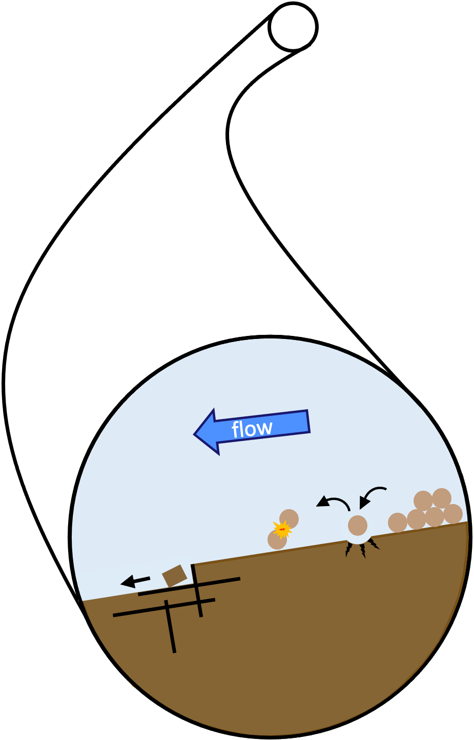
Our model builds upon previous efforts to capture the complexity of mixed bedrock-alluvial systems
Bedrock Components
Plucking via stream power
Alluvial Components
Near threshold channels, constant shear stress, self-adjusted width
Coarse sediment transport
Downstream fining
Modified from Wickert and Schildgen, 2019
Mixed Components
Abrasion
Process efficiency depends on sediment cover
Notes:
Bedload sediment transport in equilibrium channels
Channel width adjustment to flow and sediment characteristics
Abrasion of bedrock by mobile sediment
Plucking of sediment
Sediment cover effects
Loss of gravel-sized sediment via grain attrition

Slide 6
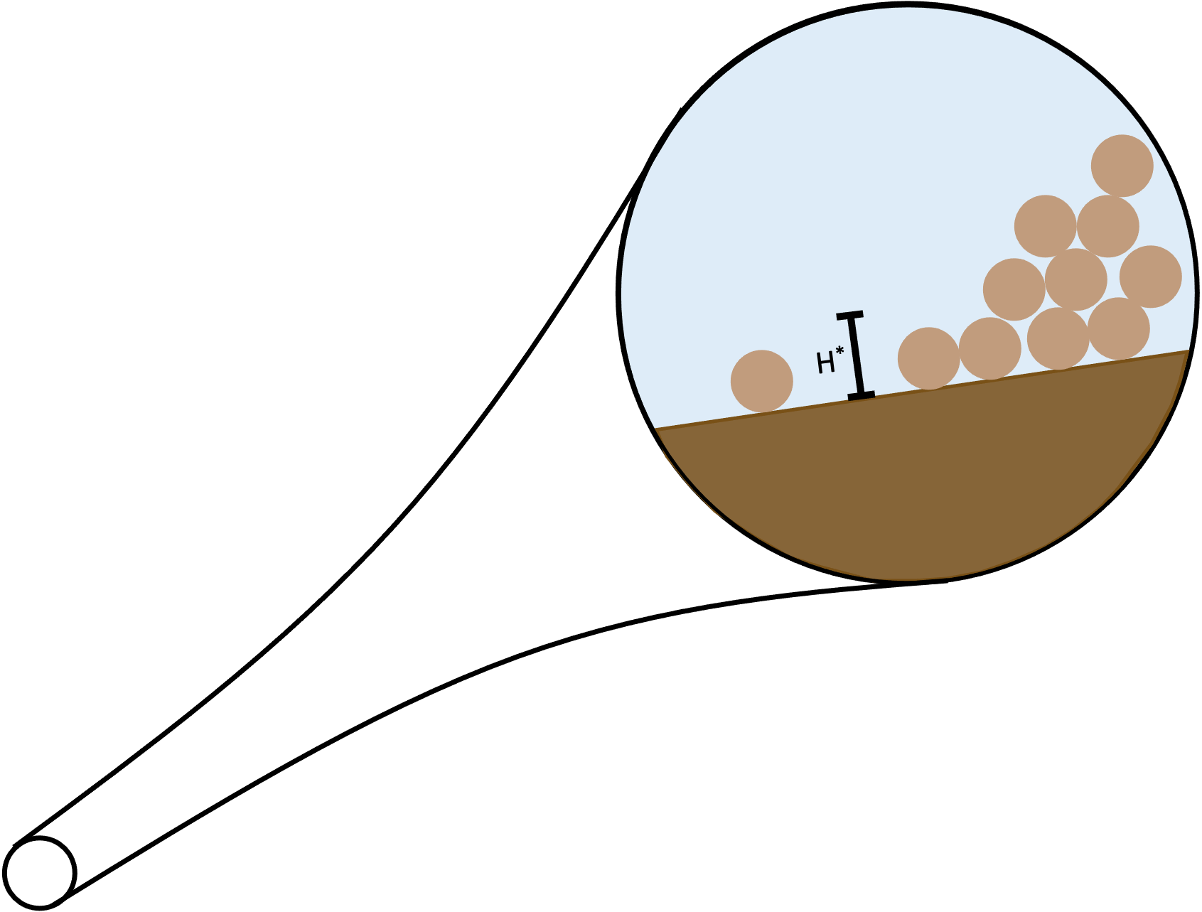
Our model builds upon previous efforts to capture the complexity of mixed bedrock-alluvial systems
Bedrock Components
Plucking via stream power
Alluvial Components
Near threshold channels, constant shear stress, self-adjusted width
Coarse sediment transport
Downstream fining
Modified from Wickert and Schildgen, 2019
Mixed Components
Abrasion
Process efficiency depends on sediment cover
Notes:
Bedload sediment transport in equilibrium channels
Channel width adjustment to flow and sediment characteristics
Abrasion of bedrock by mobile sediment
Plucking of sediment
Sediment cover effects
Loss of gravel-sized sediment via grain attrition

Slide 7
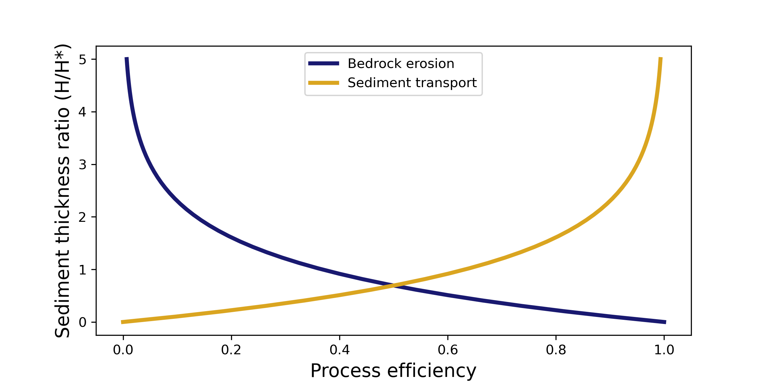
Our model builds upon previous efforts to capture the complexity of mixed bedrock-alluvial systems
Bedrock Components
Plucking via stream power
Alluvial Components
Near threshold channels, constant shear stress, self-adjusted width
Coarse sediment transport
Downstream fining
Modified from Wickert and Schildgen, 2019
Mixed Components
Abrasion
Process efficiency depends on sediment cover
Modified from Shobe et al., 2017
Notes:
Bedload sediment transport in equilibrium channels
Channel width adjustment to flow and sediment characteristics
Abrasion of bedrock by mobile sediment
Plucking of sediment
Sediment cover effects
Loss of gravel-sized sediment via grain attrition

Slide 8
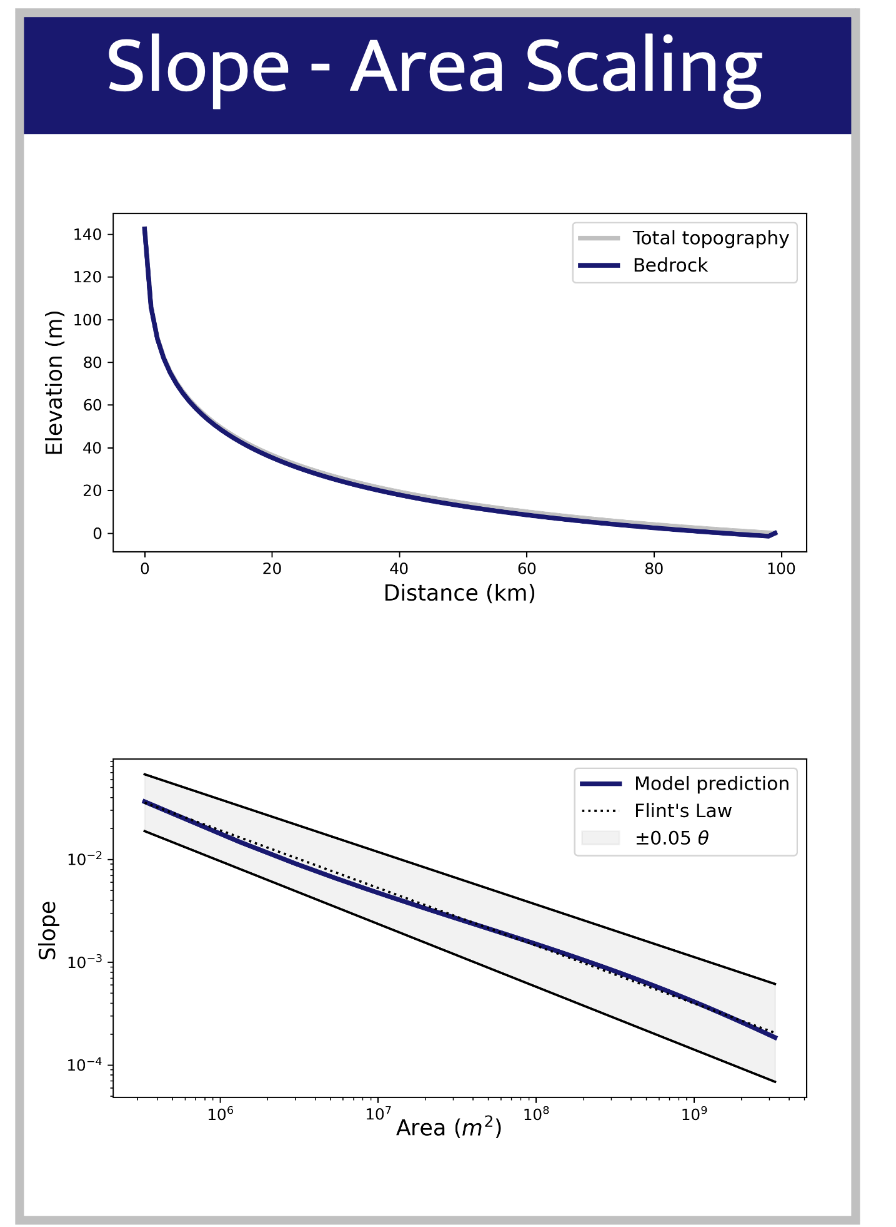
Our model reproduces expected fluvial behavior…
Notes:
Show single lithology cases both for these plots and analytical solutions (if shown at all) – save this two lith stuff for last slide (future applications)

Slide 9
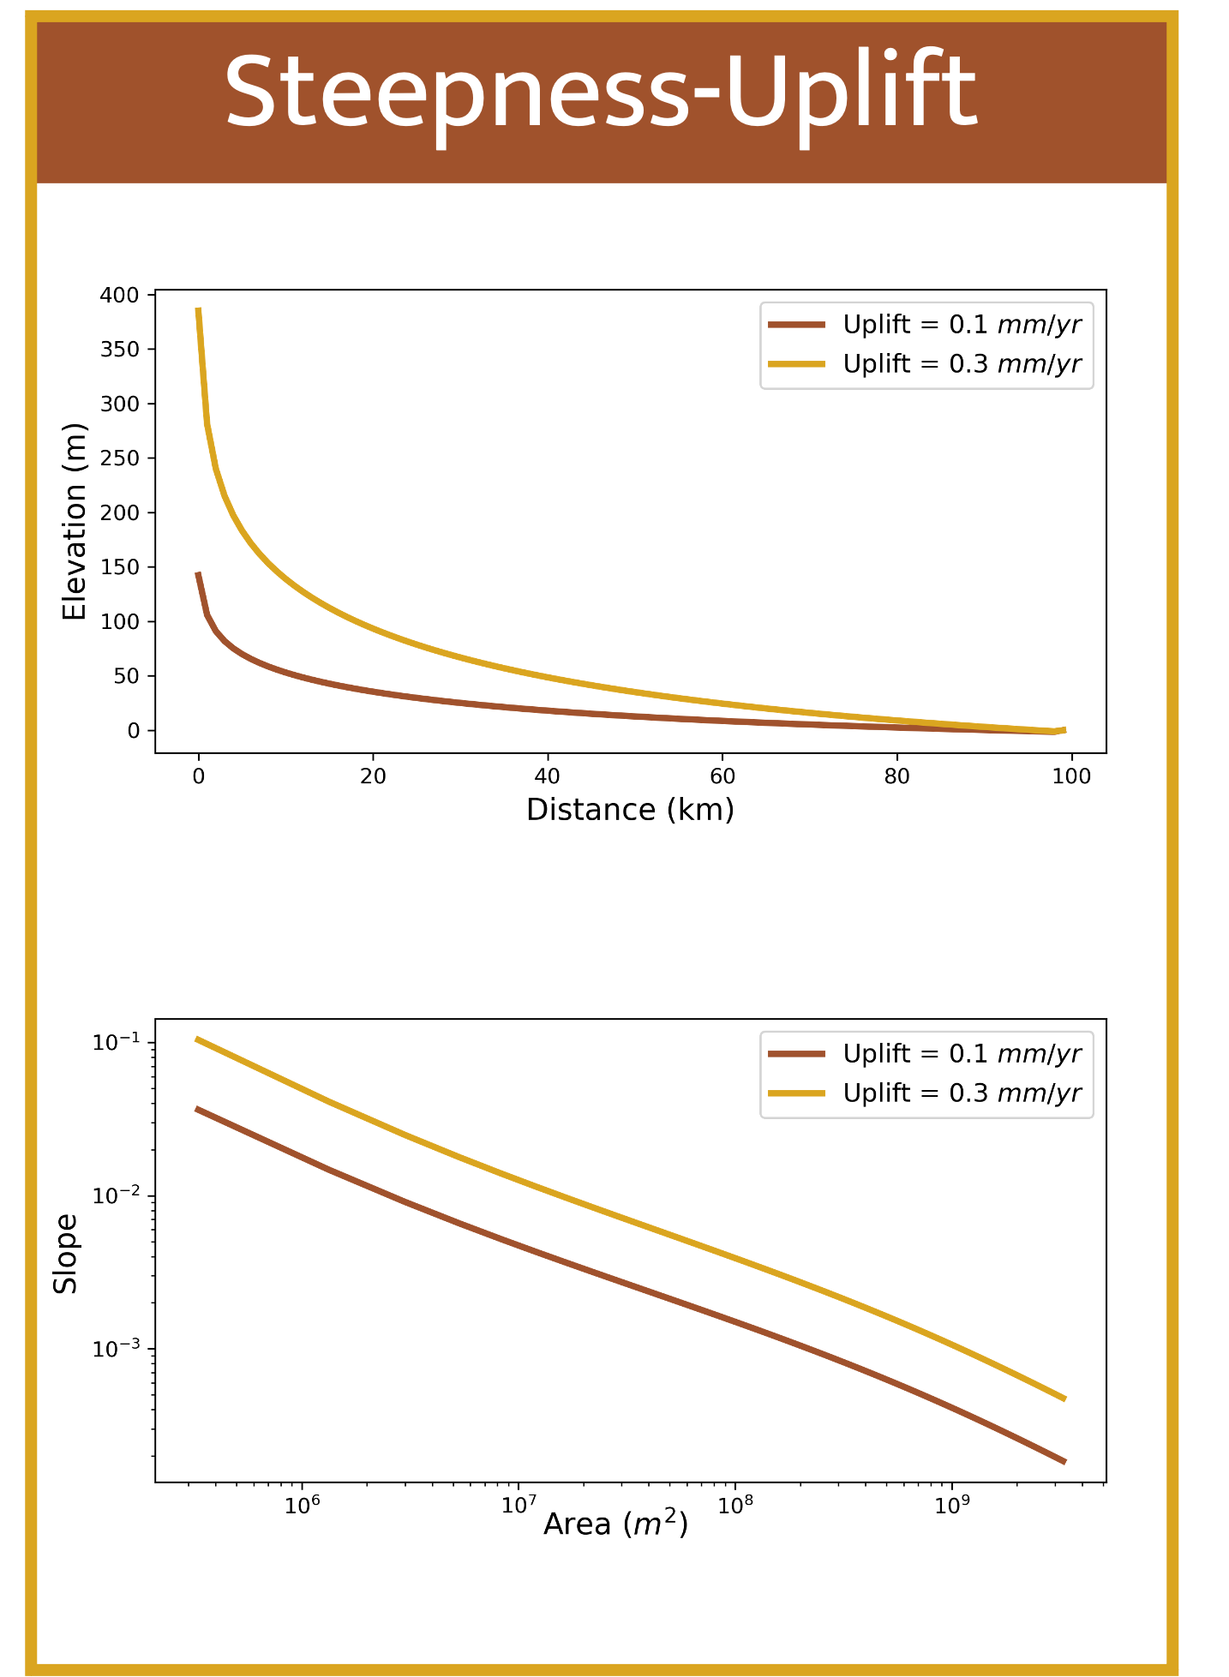
Our model reproduces expected fluvial behavior…
Notes:
Show single lithology cases both for these plots and analytical solutions (if shown at all) – save this two lith stuff for last slide (future applications)

Slide 10
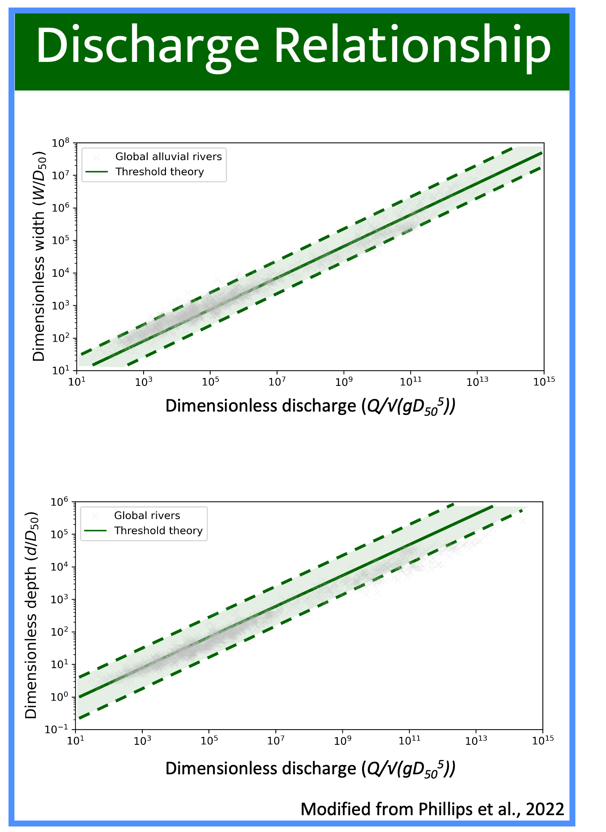
Our model reproduces expected fluvial behavior…
Notes:
Show single lithology cases both for these plots and analytical solutions (if shown at all) – save this two lith stuff for last slide (future applications)

Slide 11
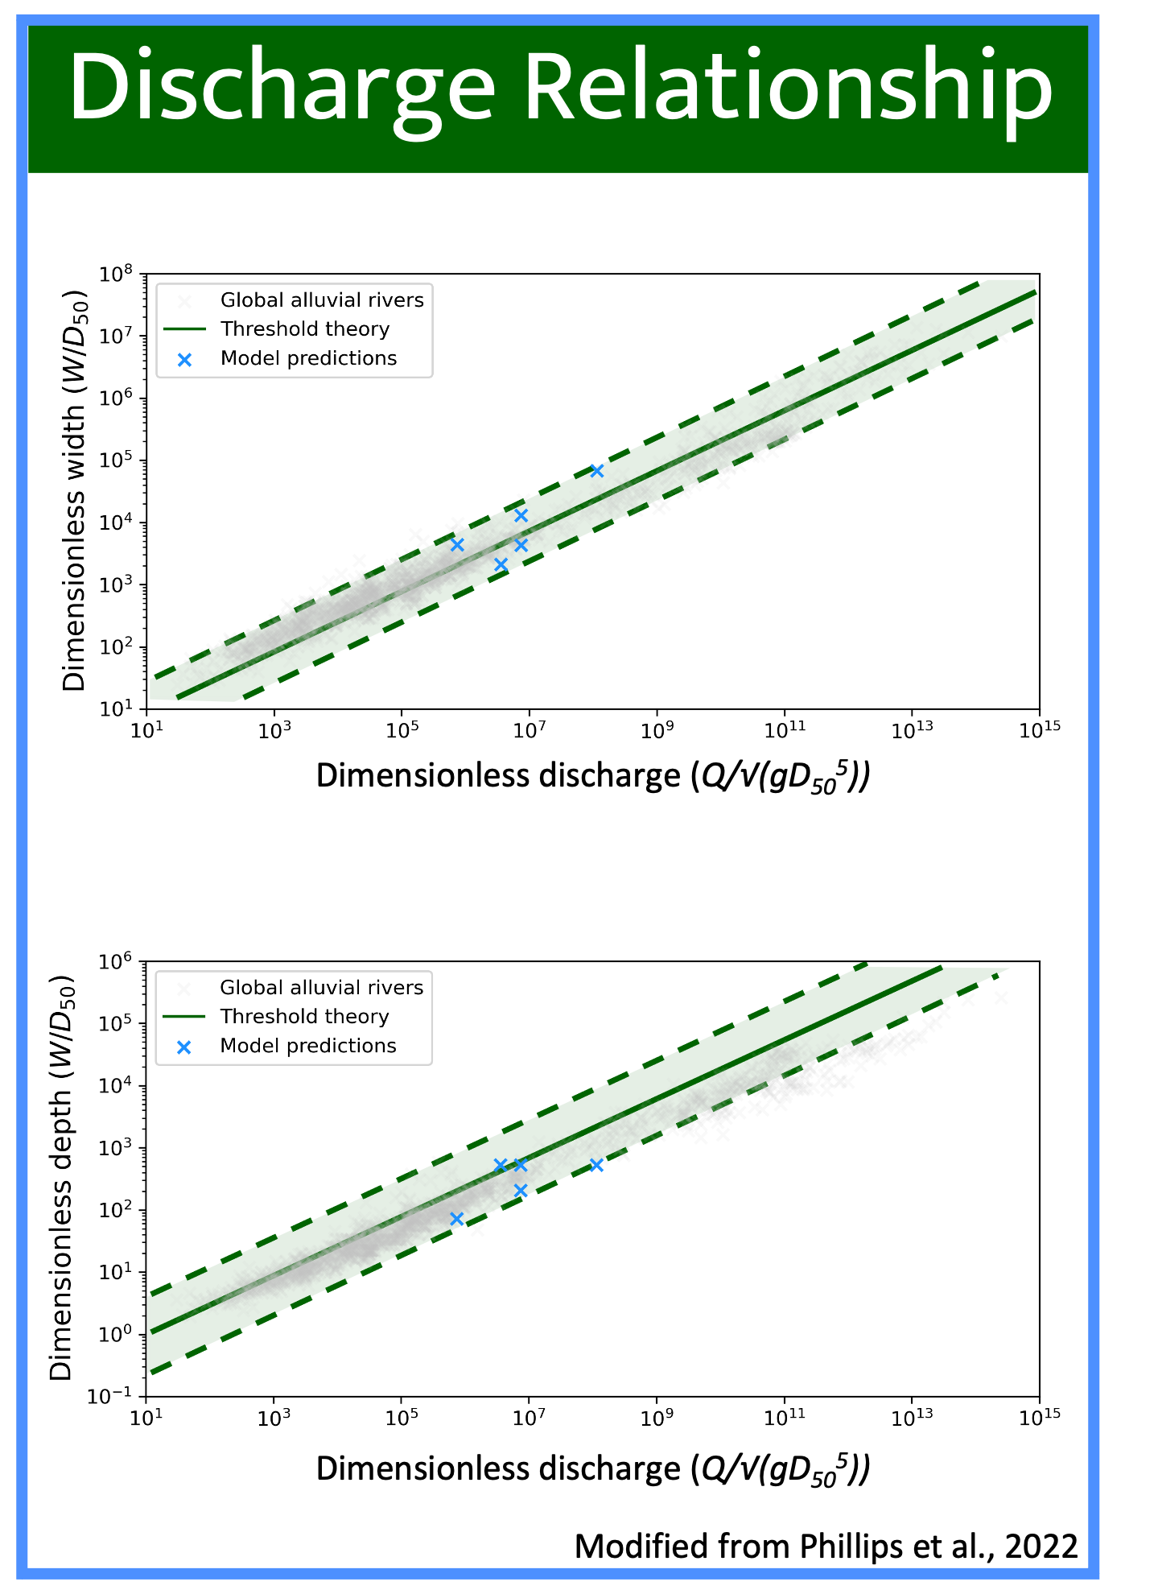
Our model reproduces expected fluvial behavior…
Notes:
Show single lithology cases both for these plots and analytical solutions (if shown at all) – save this two lith stuff for last slide (future applications)

Slide 12
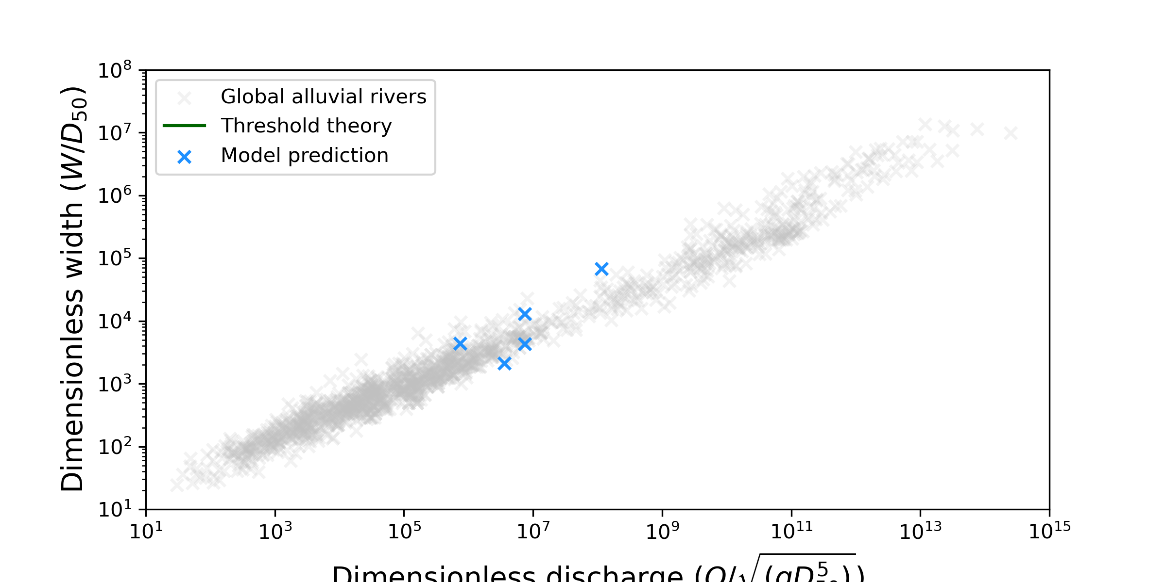
…while also providing insight to mixed bedrock-alluvial systems
Dimensionless discharge (Q/√(gD₅₀⁵))

Slide 13
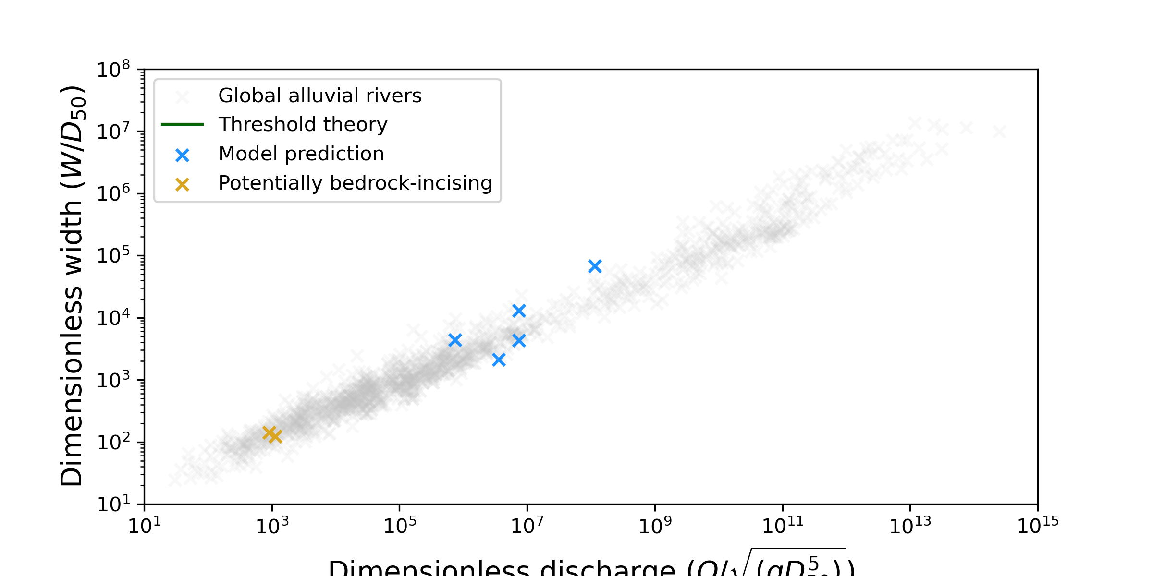
…while also providing insight to mixed bedrock-alluvial systems
Dimensionless discharge (Q/√(gD₅₀⁵))

Slide 14
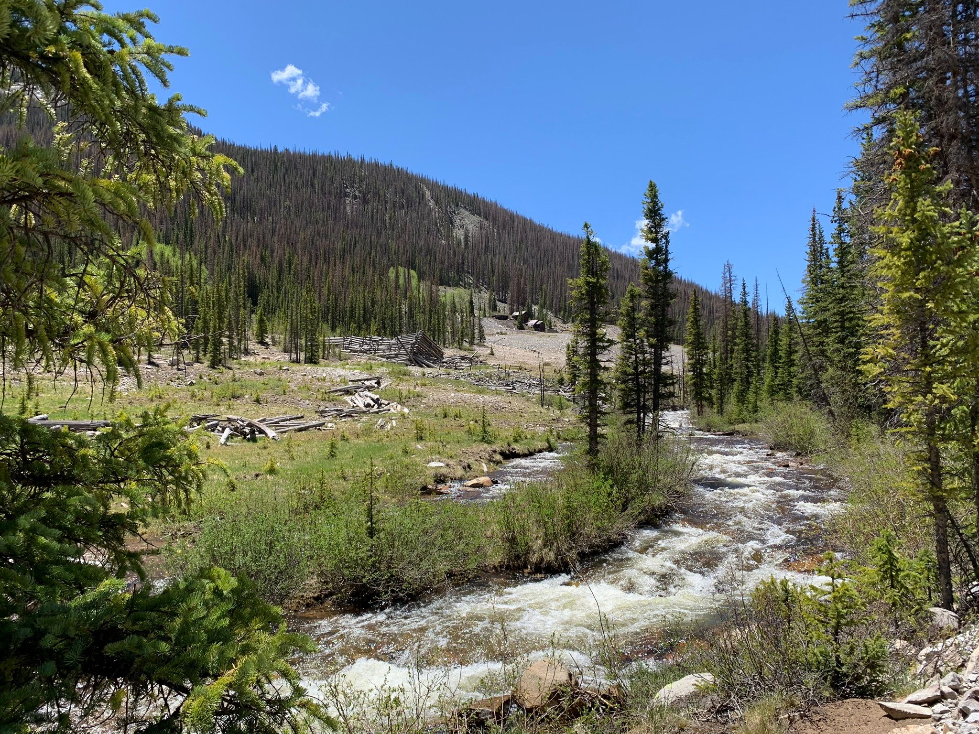
…while also providing insight to mixed bedrock-alluvial systems
Dimensionless discharge (Q/√(gD₅₀⁵))
Chalk Creek, James Sanders

Slide 15
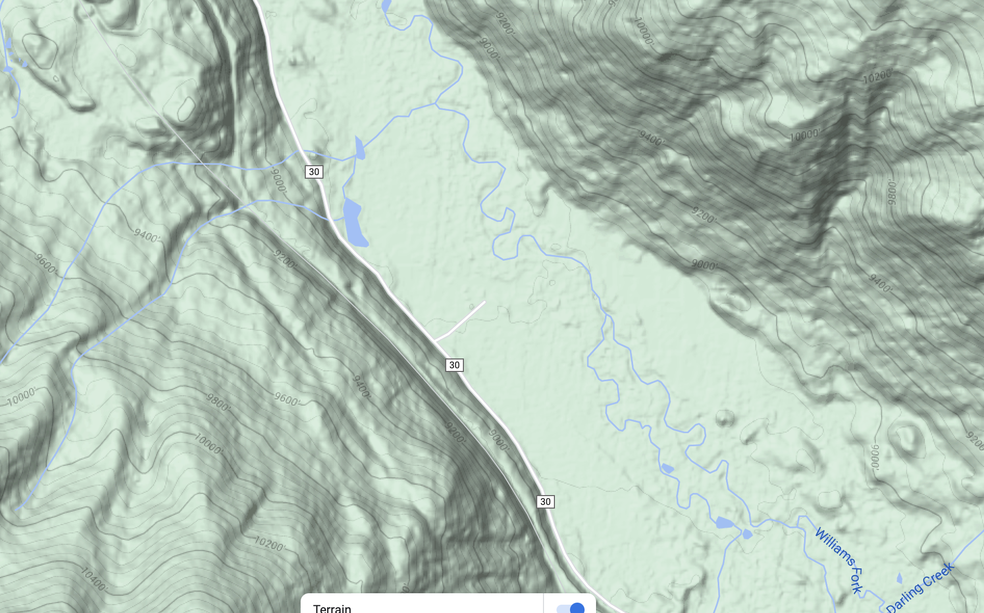
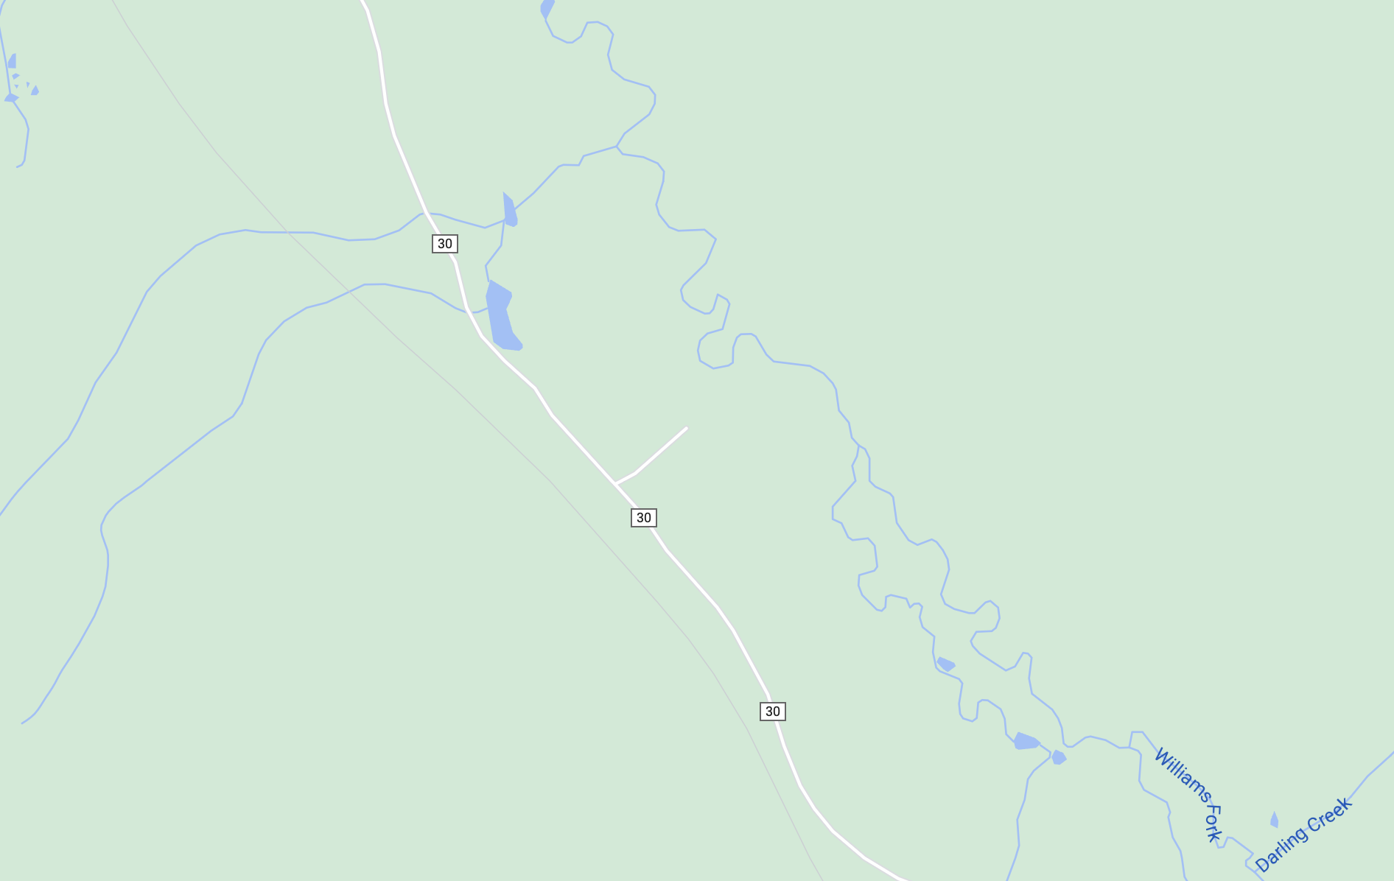
…while also providing insight to mixed bedrock-alluvial systems
Dimensionless discharge (Q/√(gD₅₀⁵))
Some of these “near-threshold” rivers are probably incising bedrock!
500 m
Google Maps

Slide 16
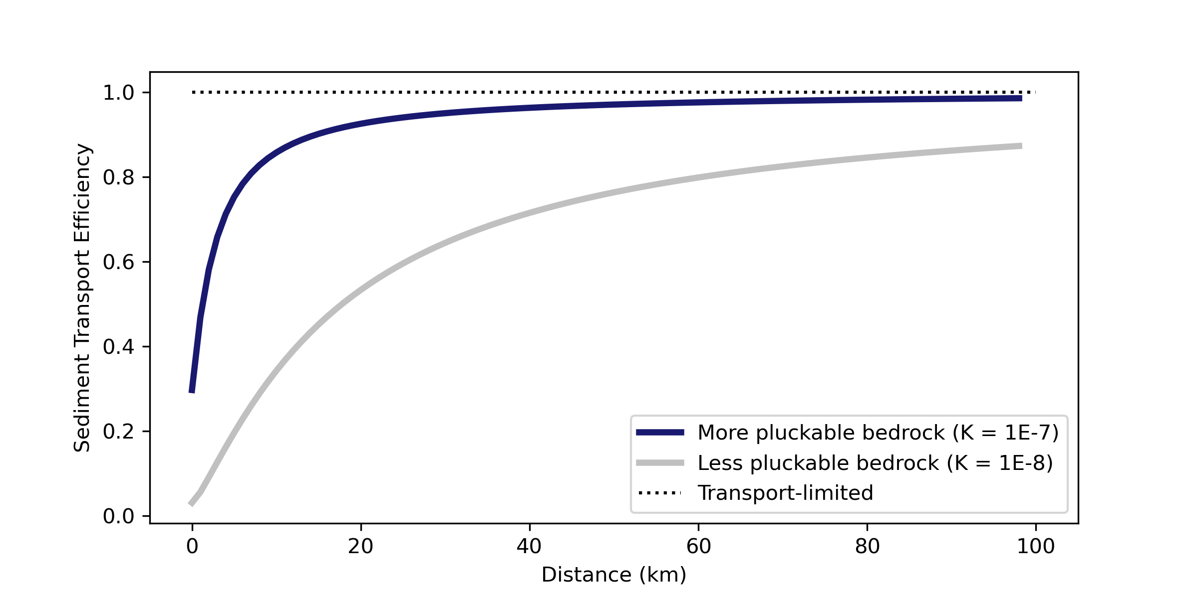
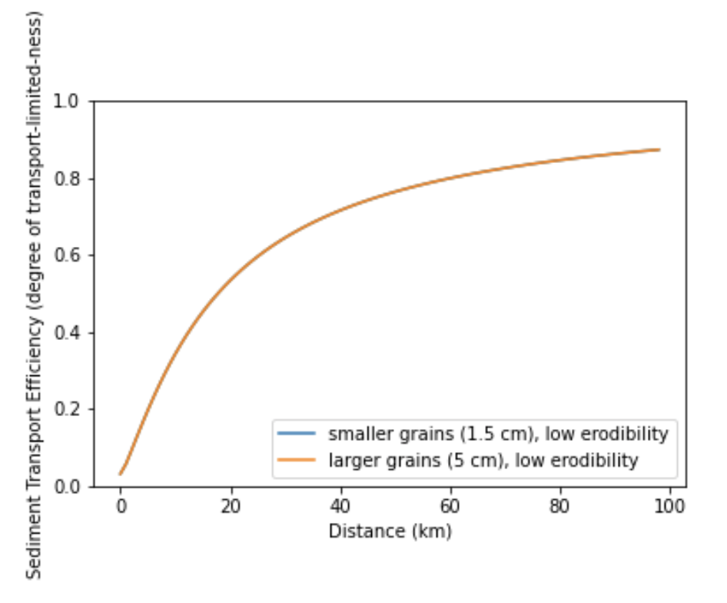
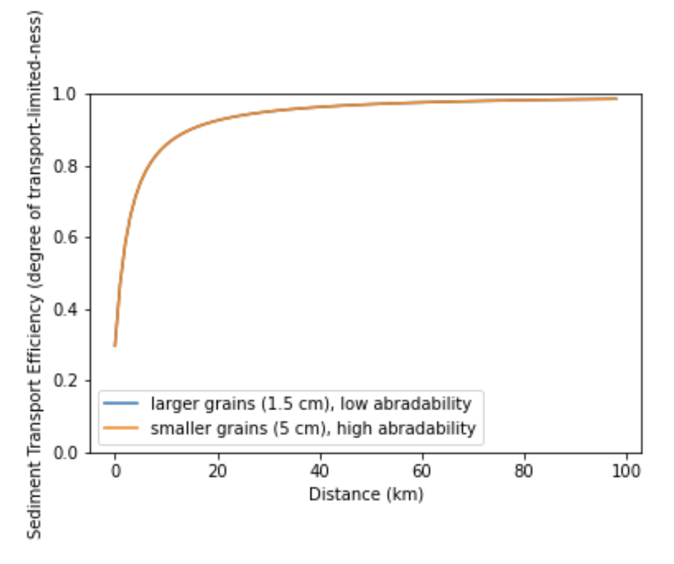
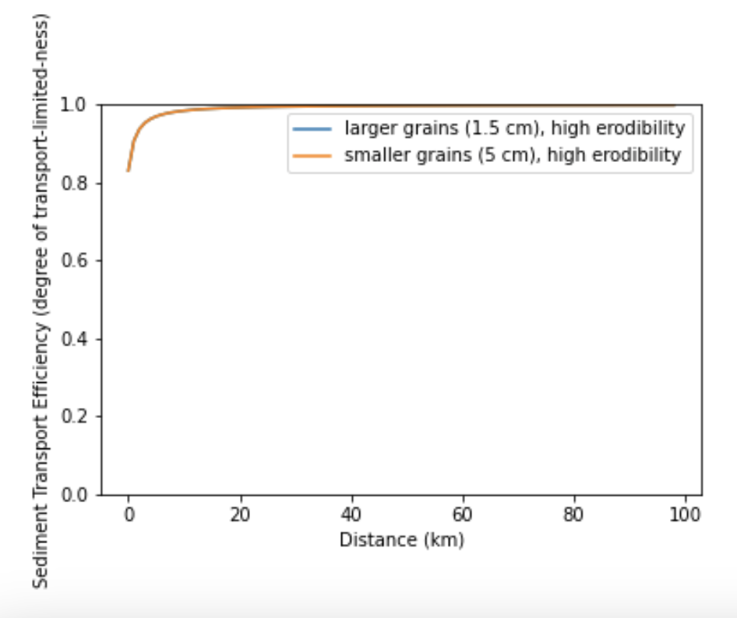
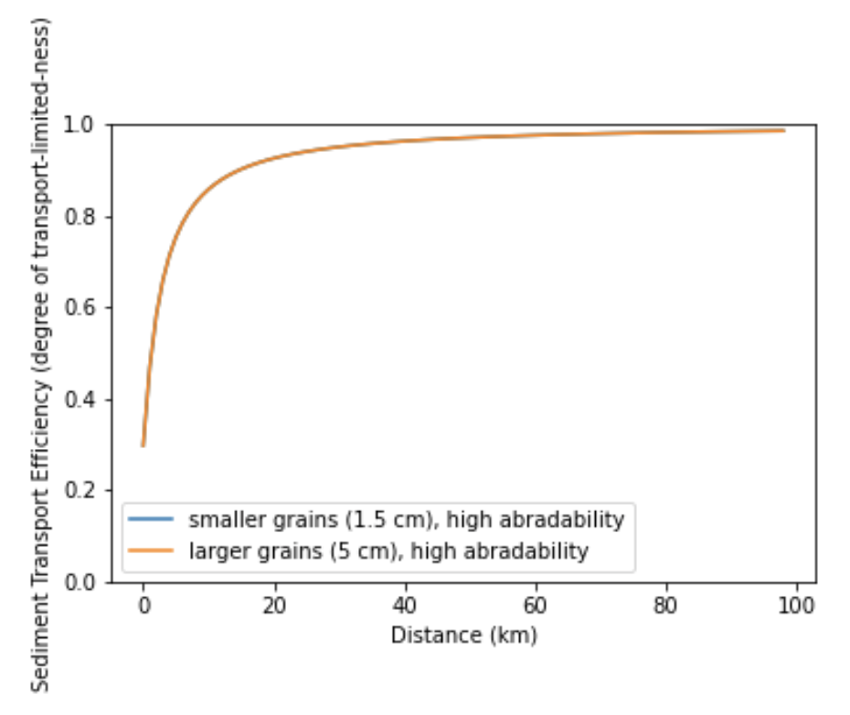
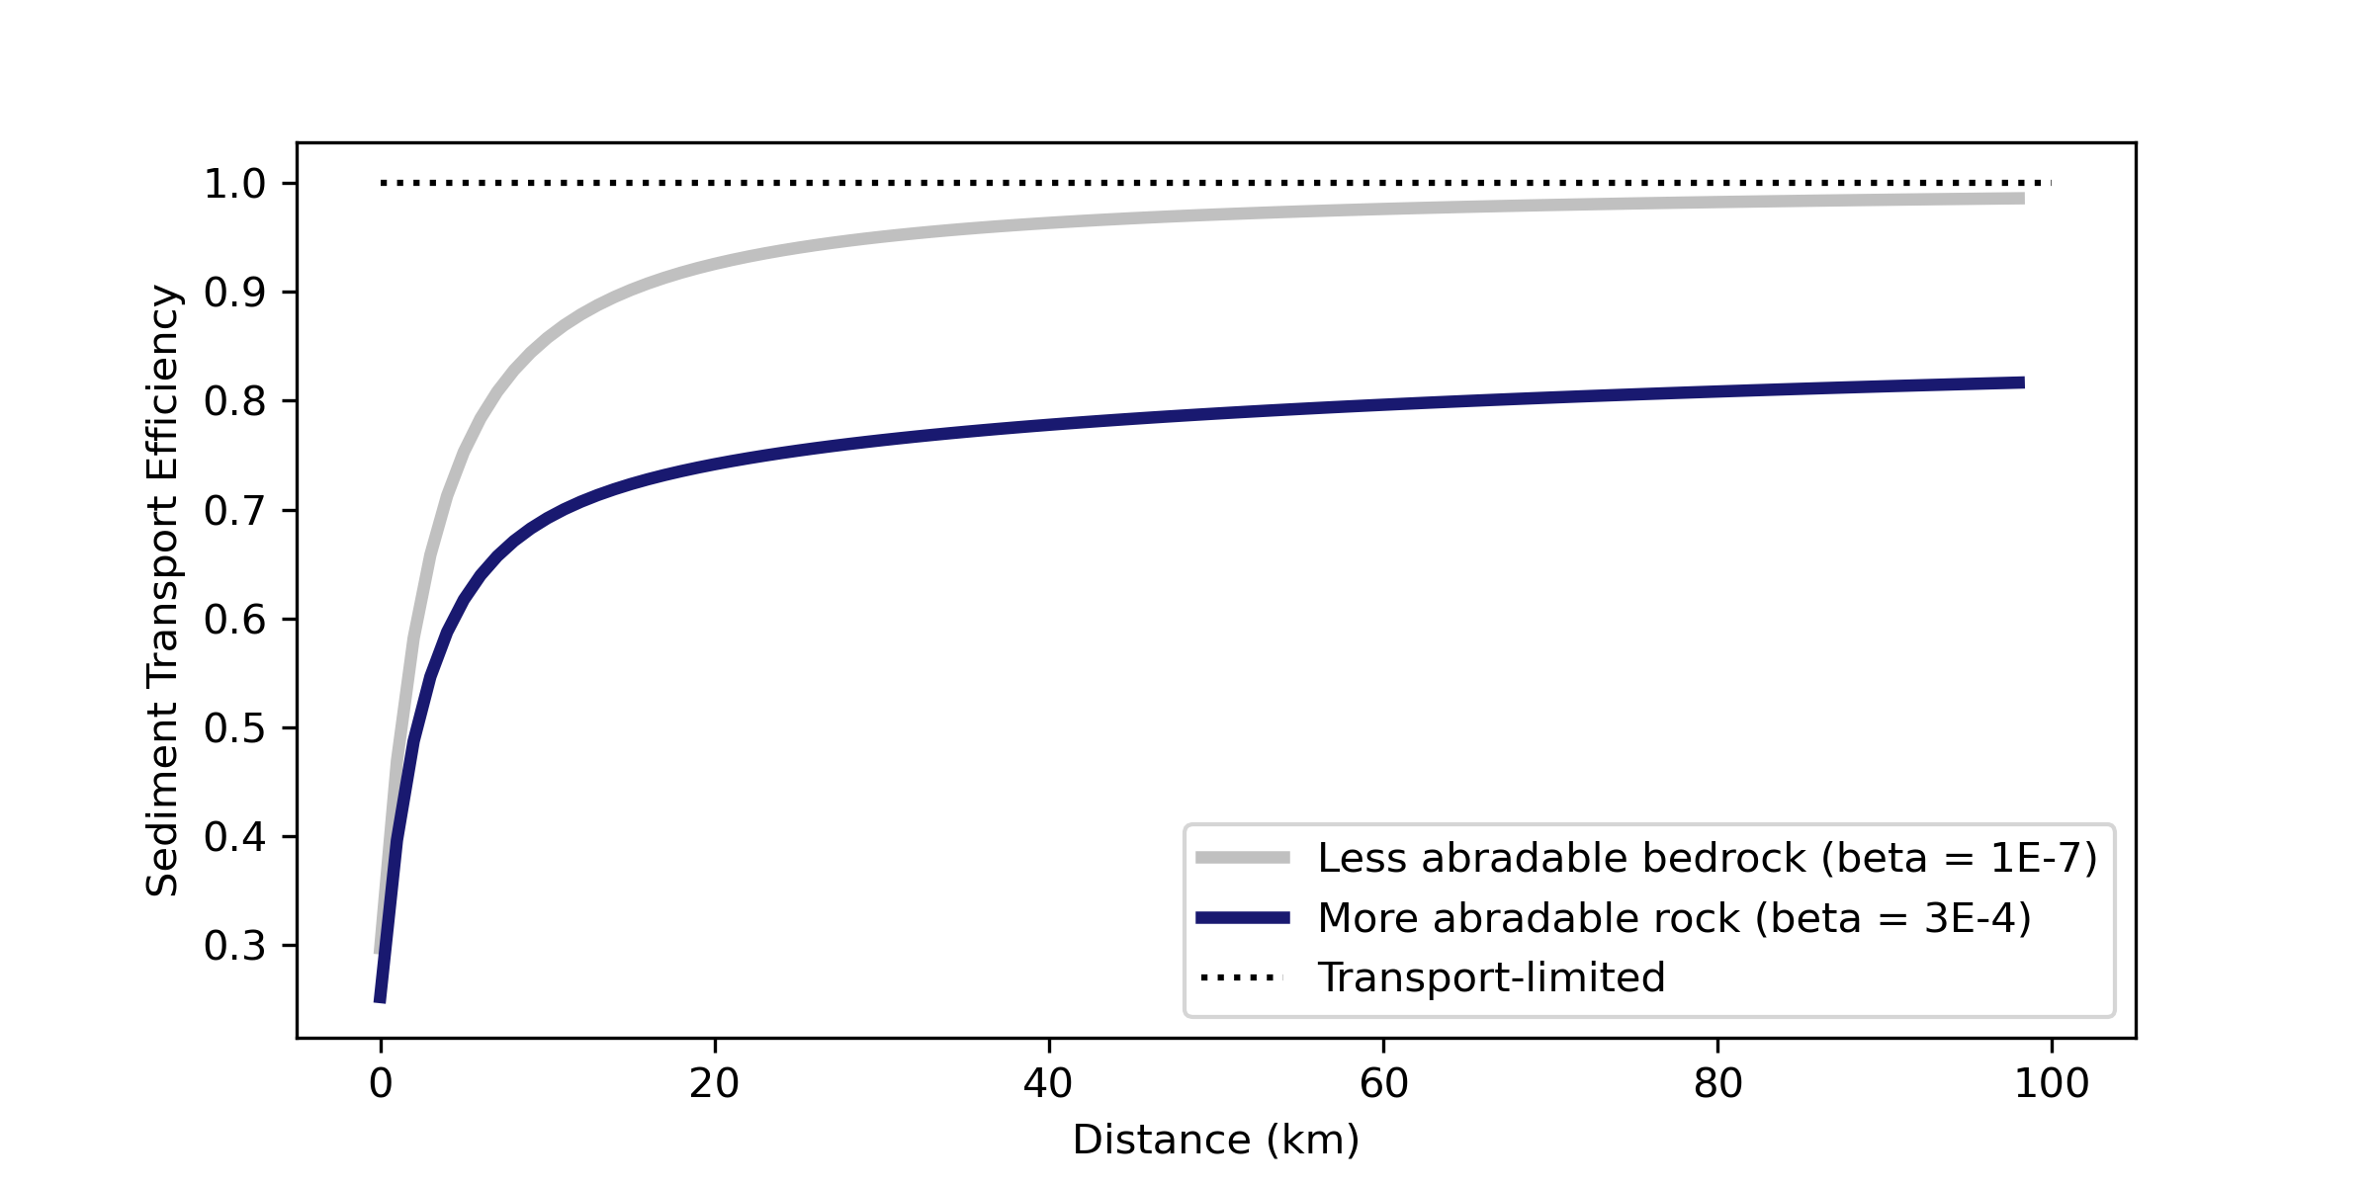
…while also providing insight to mixed bedrock-alluvial systems
Changing Pluckability
Changing Grain Size
Changing Abradability
Big message:
Changing persistence of sediment can have similar effect as changing bedrock erodibility
Persistence of sediment, not grain size distribution, is the key to switching between TPL and DTL

Slide 17
In Summary:
Near-threshold models can be suitable for bedrock-incising (mixed bedrock-alluvial) systems
“Transport-limited” systems can incise bedrock over long timescales
Degree of “transport-limited-ness” is strongly dependent on properties of both bedrock erodibility and sediment abradabilty

Slide 18

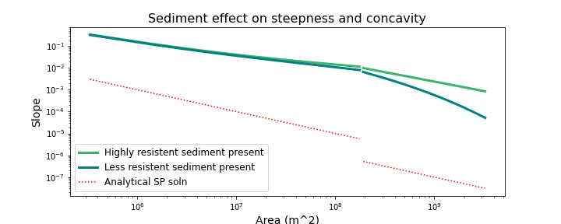
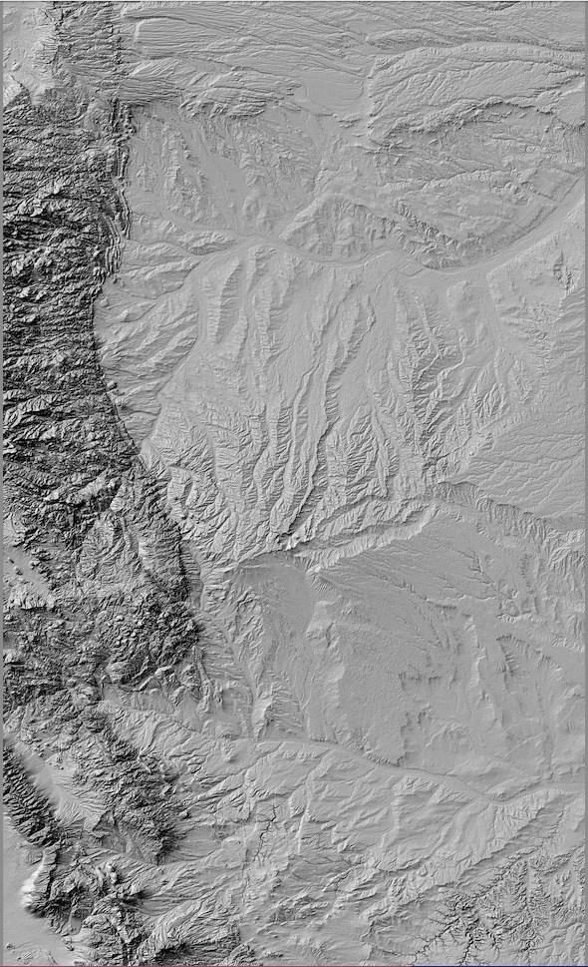
We have big plans for our model!
Investigating consequences of landslide-derived sediment in channels
Implementing a 2D version in Landlab
Modeling across range-basin systems

Slide 19
Questions?

Slide 20
Default parameters
dx = 1000
Hstar = 0.5
K = np.zeros(len(x))
K[:] = 1e-7
beta = np.zeros(len(x))
beta[:] = 1e-5
psi = 4e-5
gamma = 0.3
r = 10. # runoff rate
D = 0.015 # grain size
phi = 0.45 # porosity
baselevel_rate = 0.0001
kqs = 0.041
I = 0.01
kxb = 25
Pxb = 1./5.
kb = 8.3e-8
B_valley = kxb * (x_node**Pxb)
B_basin = (2./3.) * x_node
area = (1./3.) * x**2

Slide 21
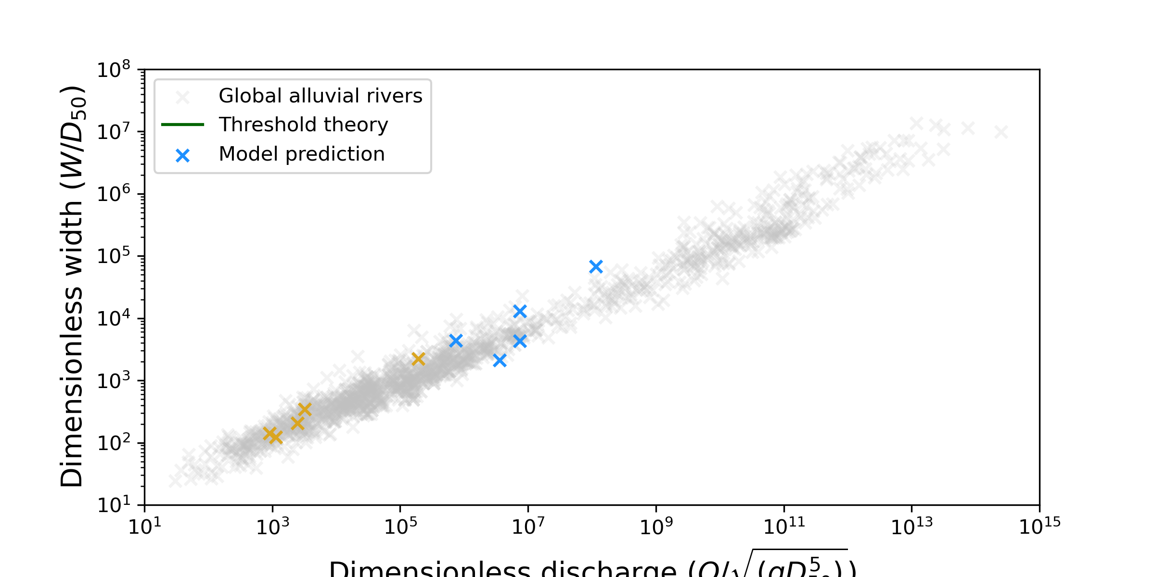
…while also providing insight to mixed bedrock-alluvial systems
500 m
Some of these “near-threshold” rivers are probably incising bedrock!
Chalk Creek, James Sanders

Slide 22
Our model reproduces expected fluvial behavior…
Notes:
Show single lithology cases both for these plots and analytical solutions (if shown at all) – save this two lith stuff for last slide (future applications)

Slide 23
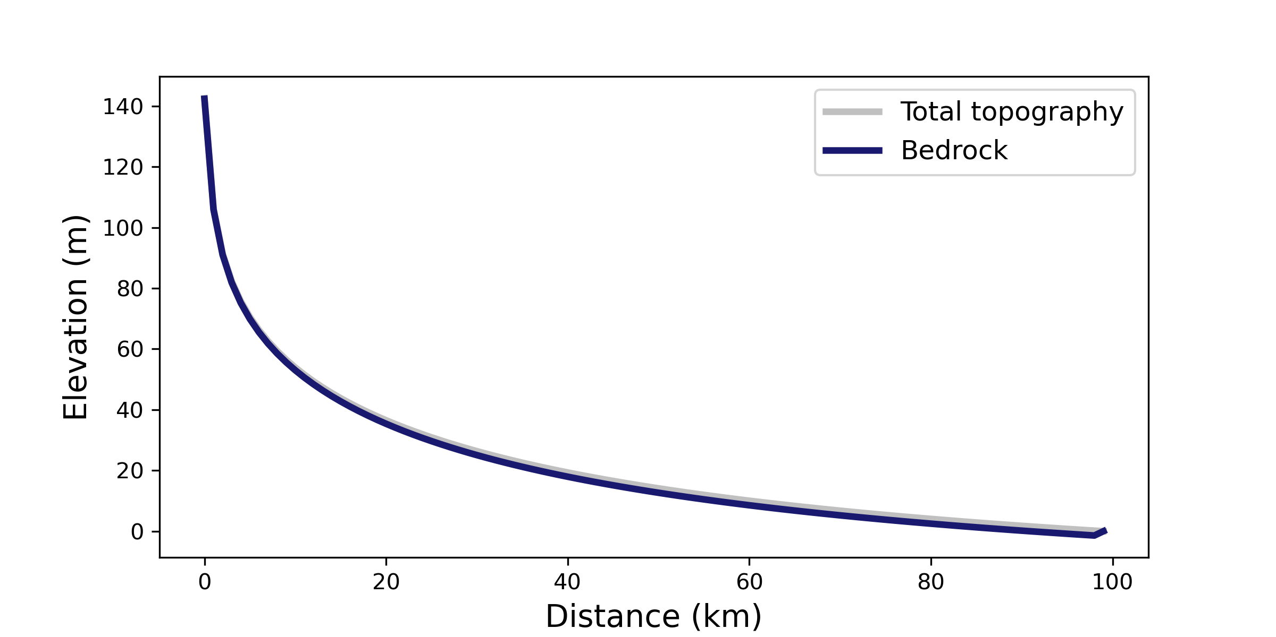
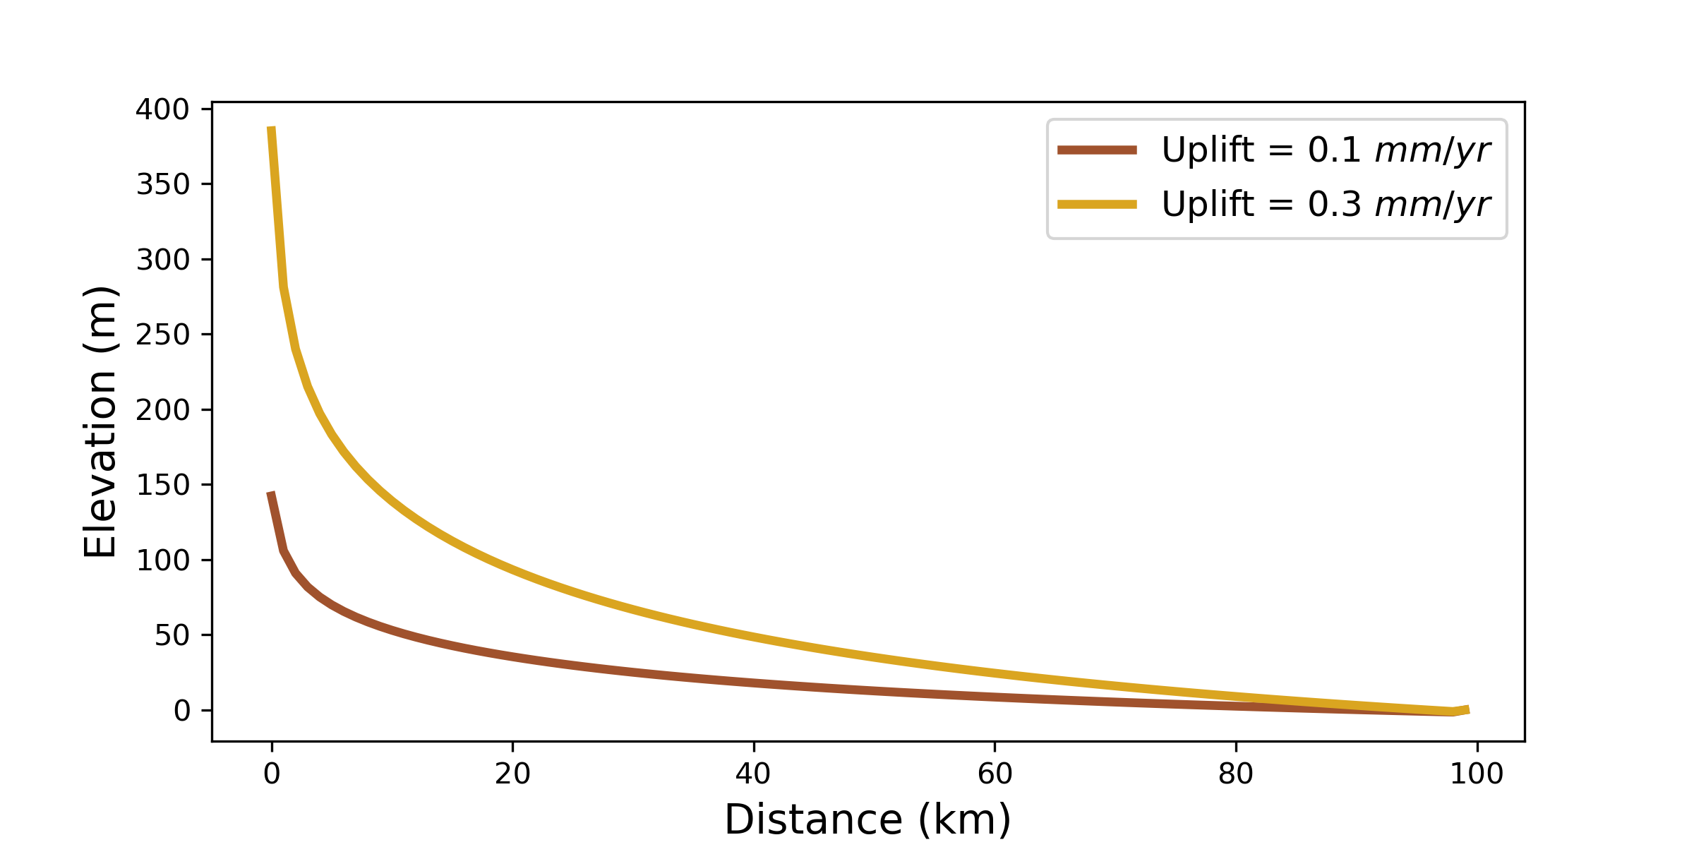
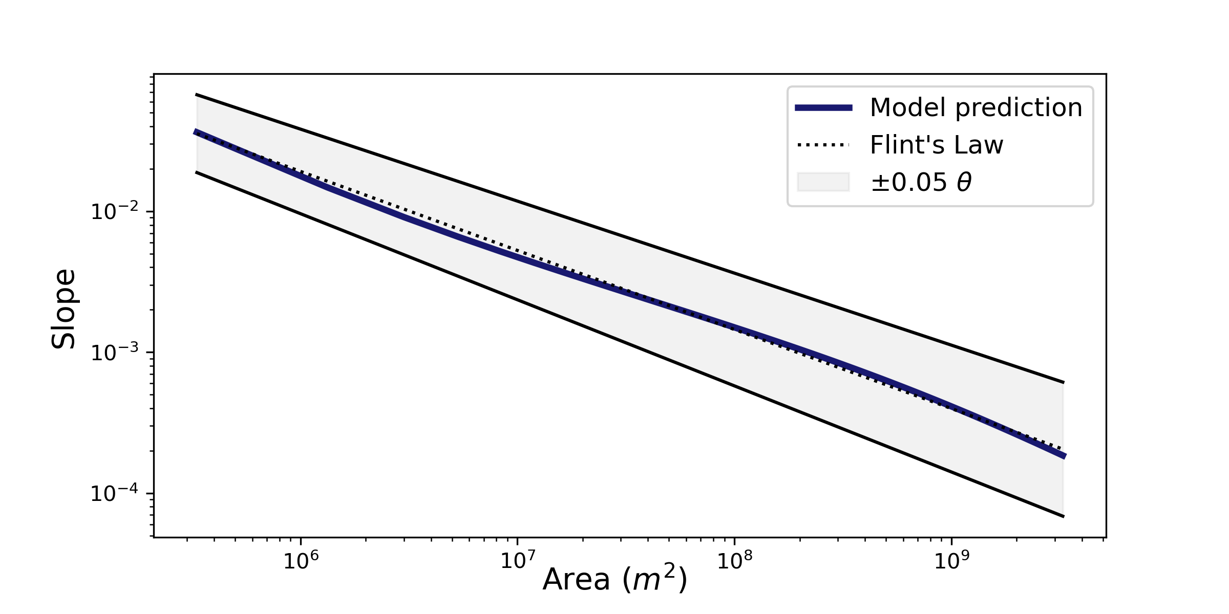
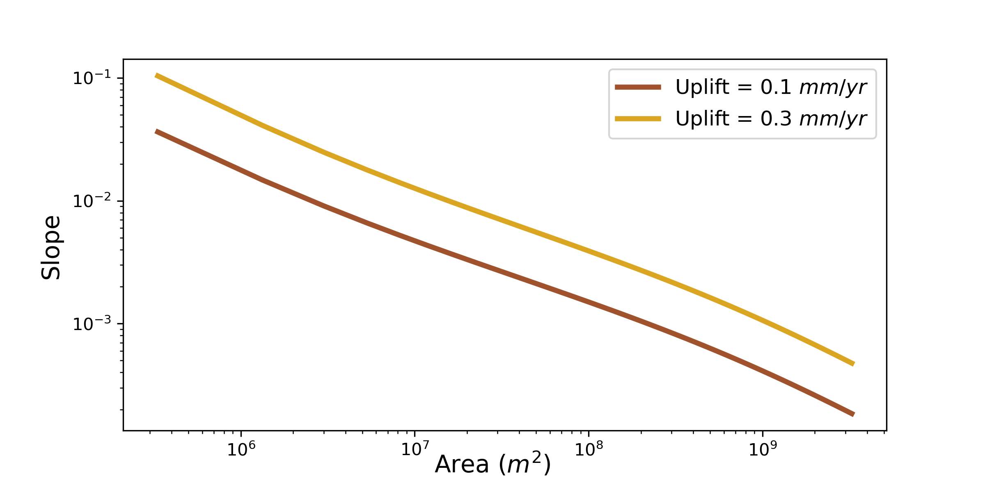
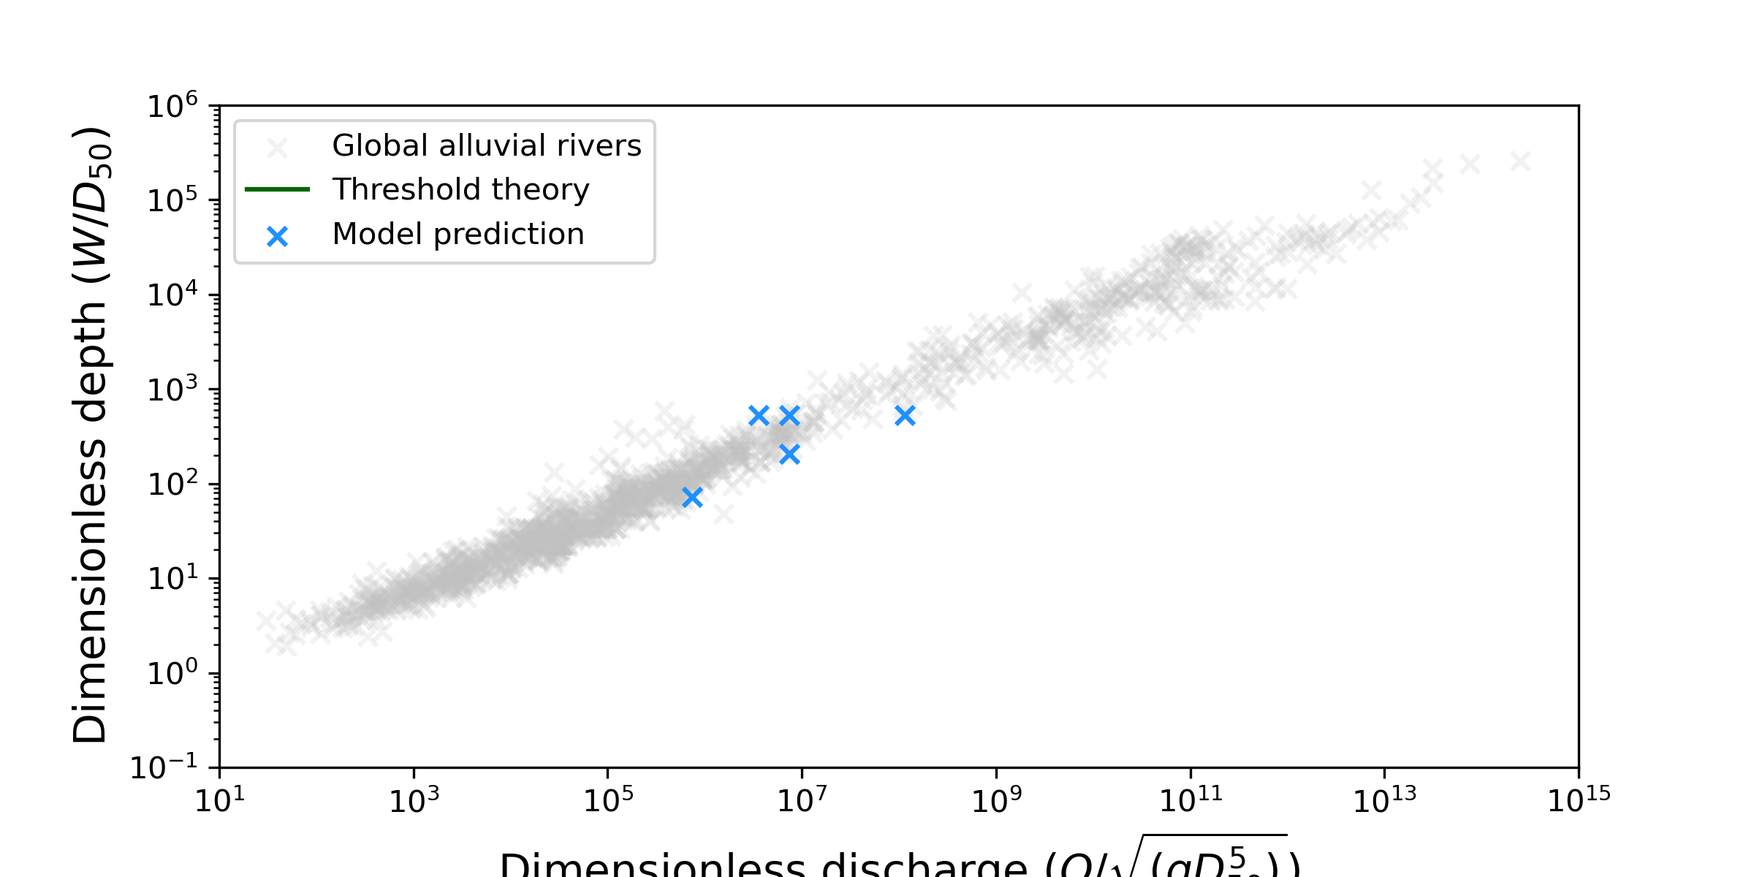
Our model reproduces expected fluvial behavior…
Slope - Area Scaling
Steepness-Uplift
Width Relationships
Notes:
Show single lithology cases both for these plots and analytical solutions (if shown at all) – save this two lith stuff for last slide (future applications)

Slide 24
Our model reproduces expected fluvial behavior…
Steepness-Uplift
Width Relationships
Notes:
Show single lithology cases both for these plots and analytical solutions (if shown at all) – save this two lith stuff for last slide (future applications)

Slide 25

Our model reproduces expected fluvial behavior…
Discharge Relationship
Dimensionless discharge (Q/√(gD₅₀⁵))
Dimensionless discharge (Q/√(gD₅₀⁵))
Modified from Phillips et al., 2022
Notes:
Show single lithology cases both for these plots and analytical solutions (if shown at all) – save this two lith stuff for last slide (future applications)

Slide 26
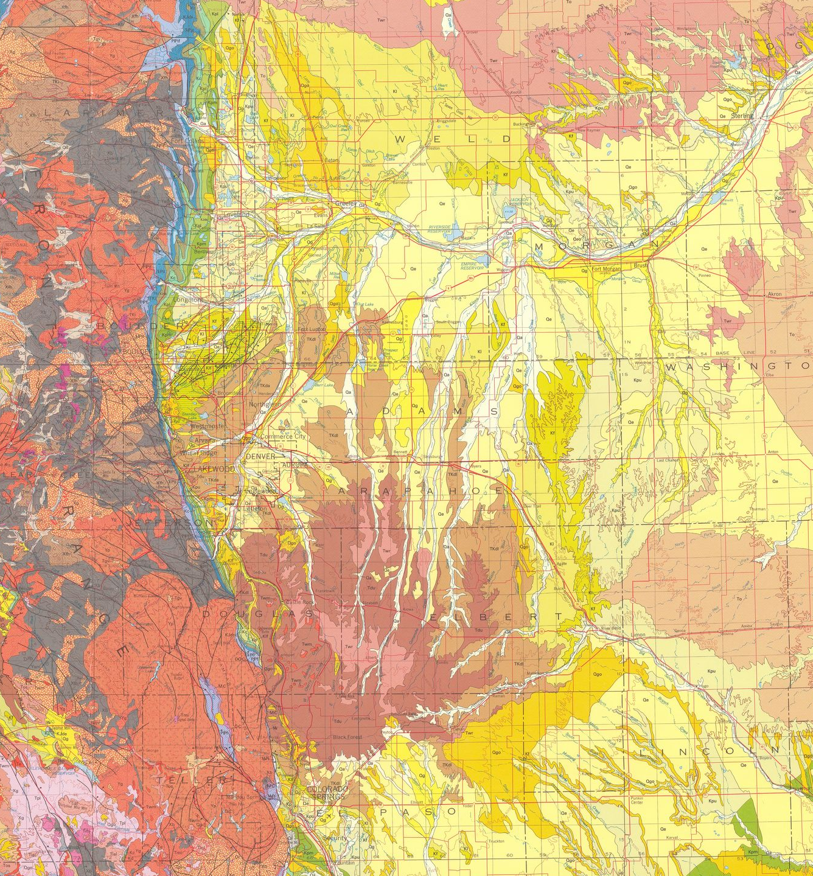
We have big plans for our model!
Investigating consequences of landslide-derived sediment in channels
Exploring channel response to external forcing
Implementing a 2D version in Landlab
Modeling across range-basin systems (show two lithology model – concavity figure)
Exploring channel response to external forcing

Slide 27
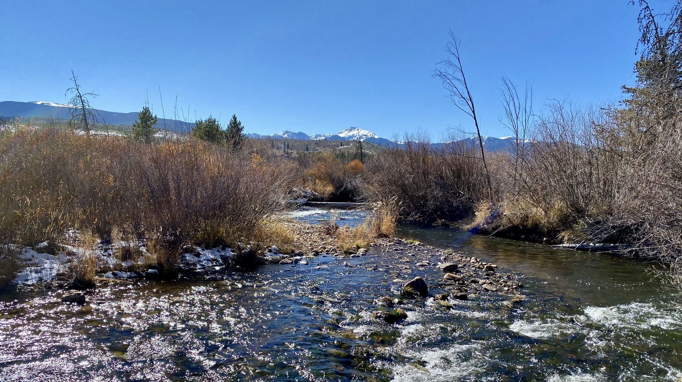
…while also adding nuance to bedrock-sediment interactions
500 m
Chalk Creek, James Sanders
Fraser River, Kamie Hartley

Slide 28
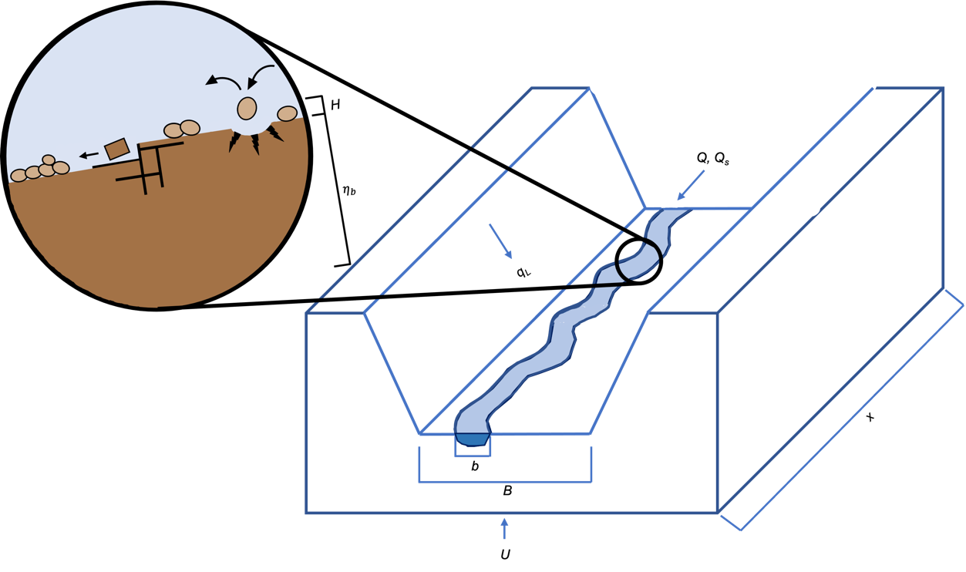
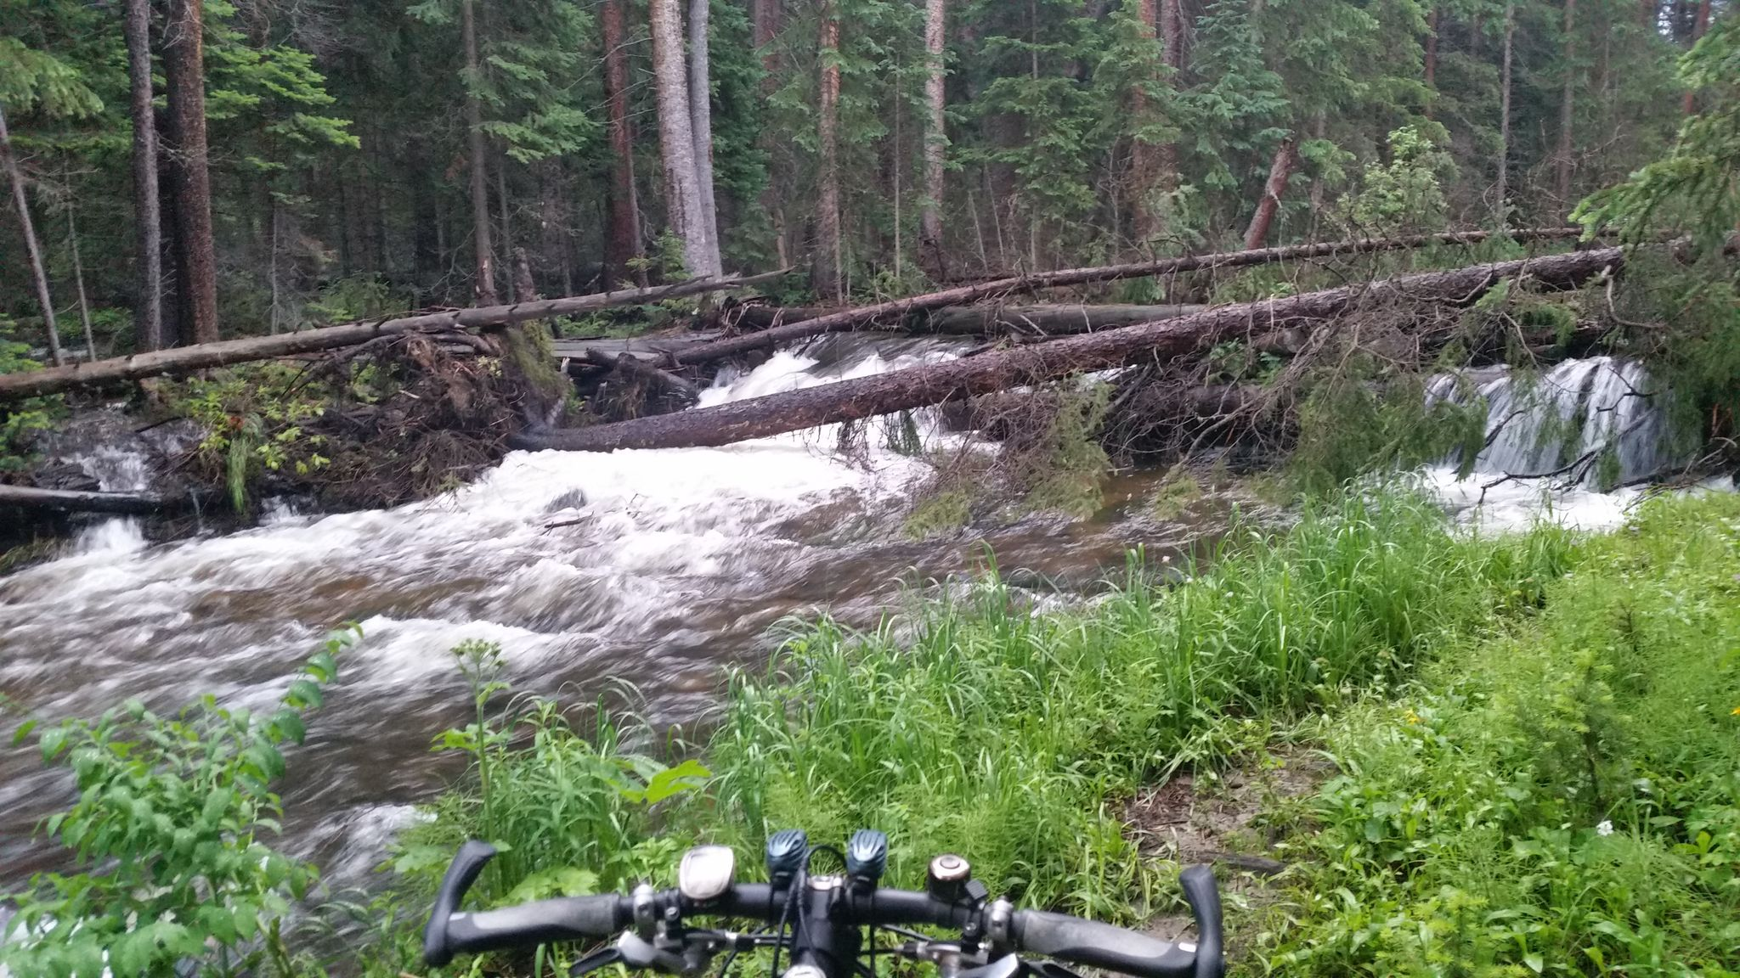
Figure 2. Schematic illustration of sediment transport and erosion in our model. Sediment enters the channel/valley from upstream and from hillslopes/tributaries, which are assumed to be lowering at the same rate as the channel. Bedrock erosion within the channel occurs via both abrasion and plucking, but only where bedrock is exposed (not covered with alluvium).
Fraser River, Josh Kastan

Slide 29
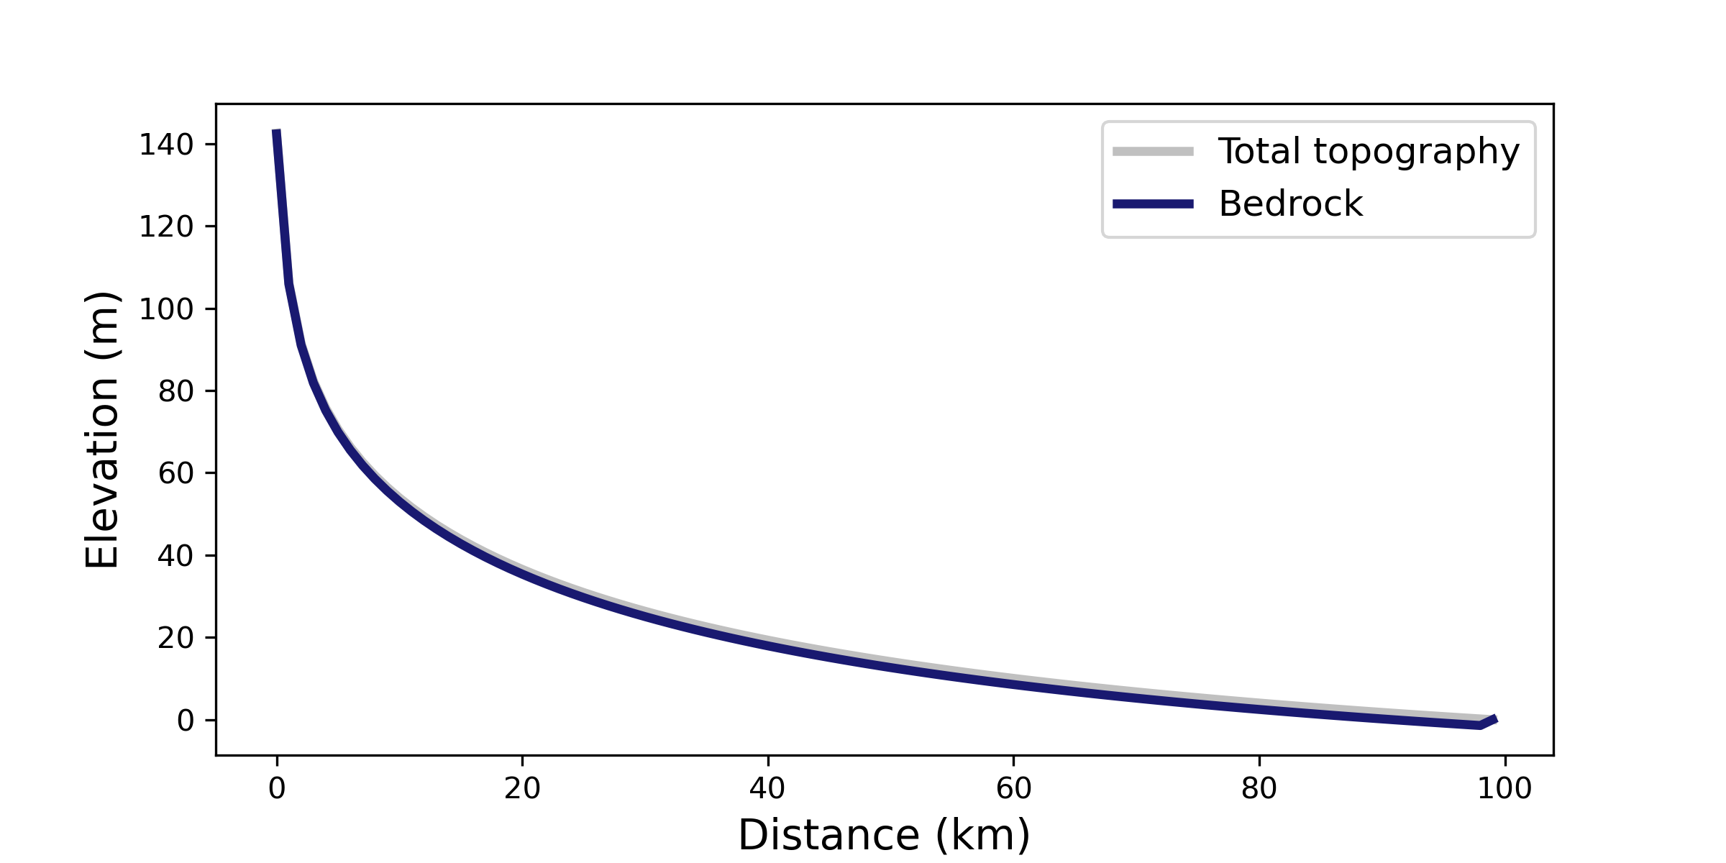
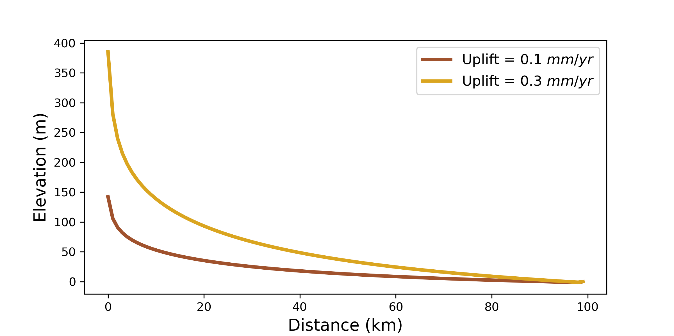
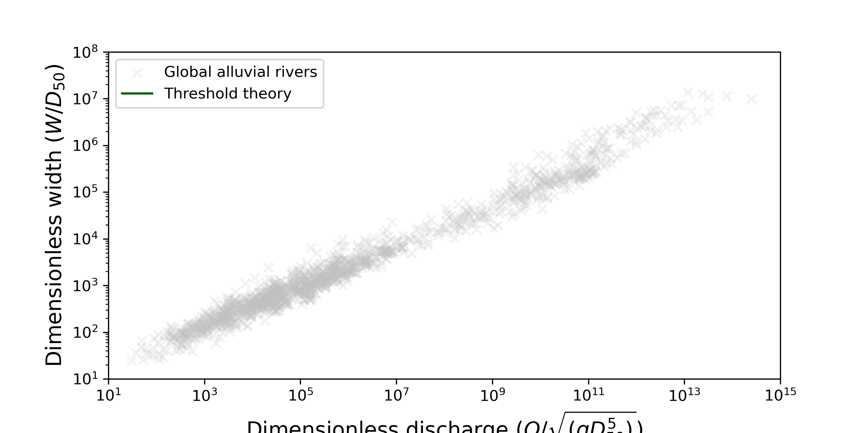
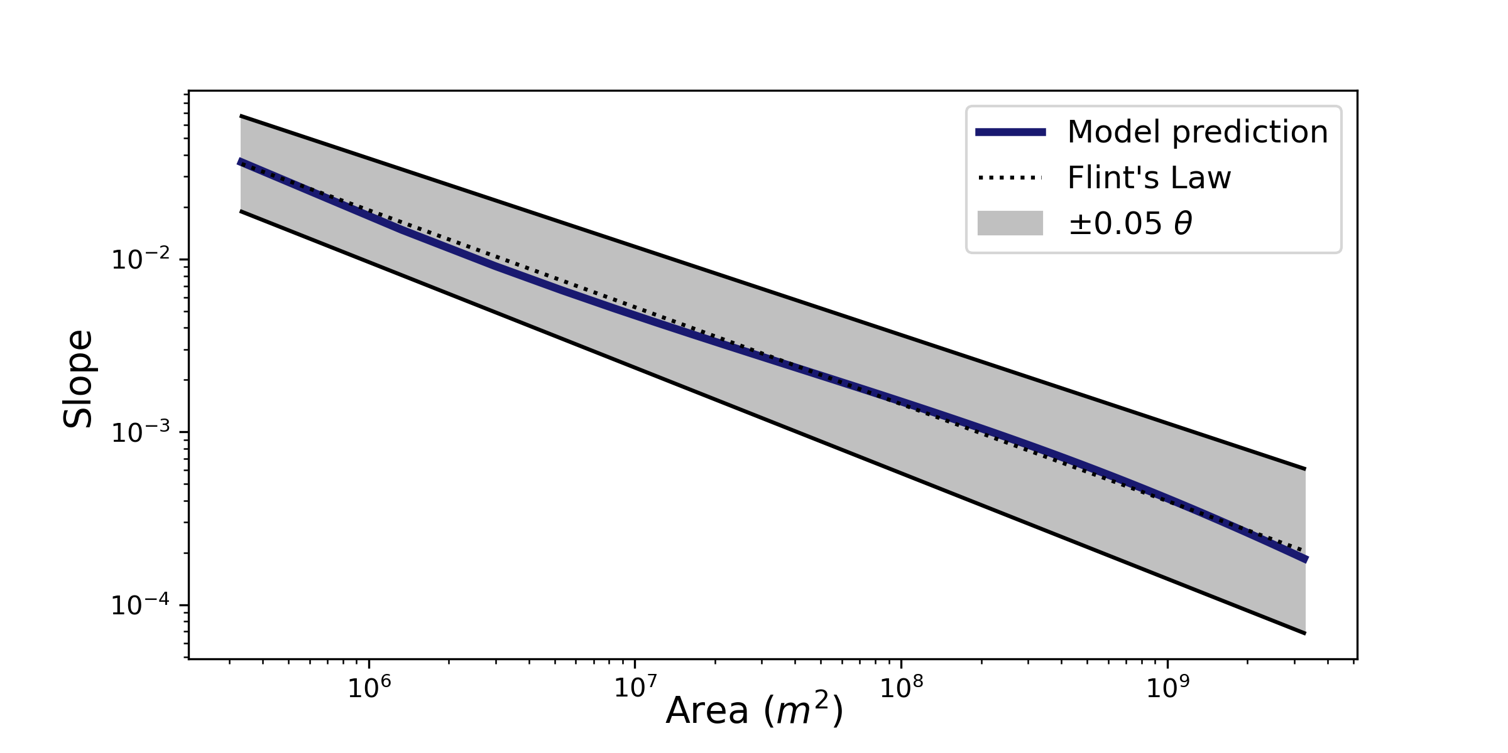
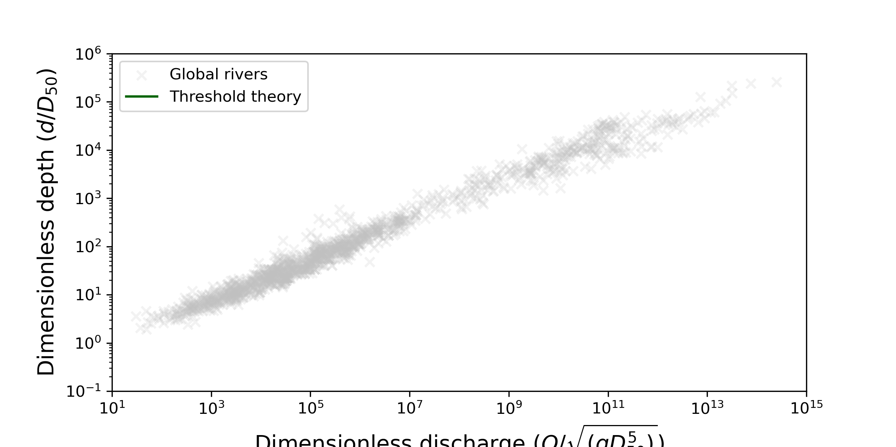
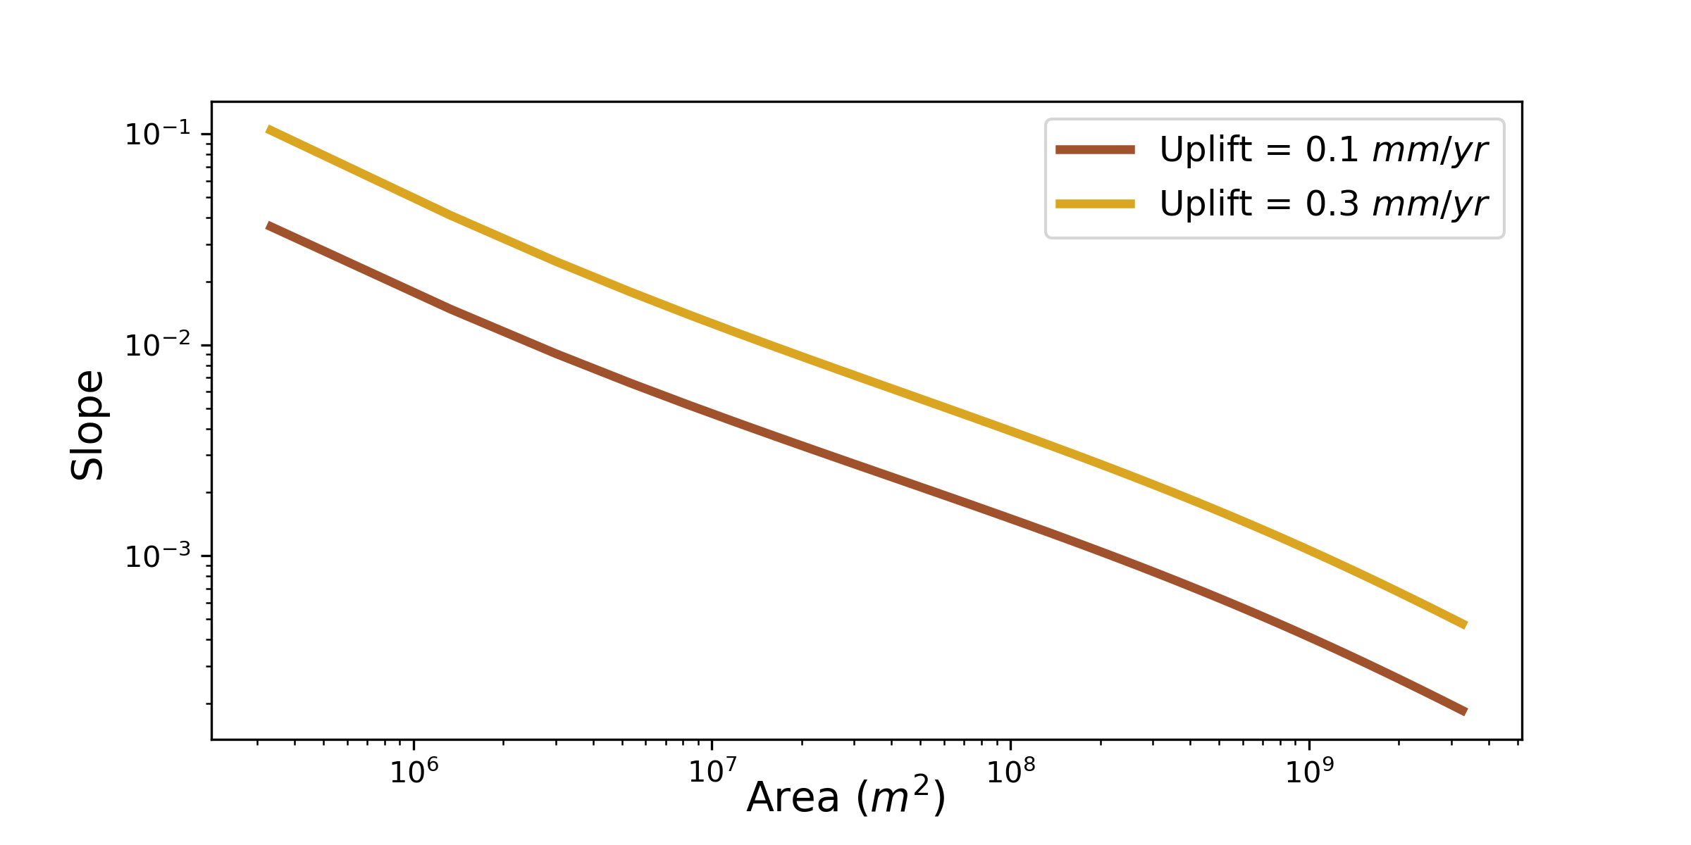
Our model reproduces expected fluvial behavior…
Slope - Area Scaling
Steepness - Uplift
Width Relationships
Notes:
Show single lithology cases both for these plots and analytical solutions (if shown at all) – save this two lith stuff for last slide (future applications)

Slide 30
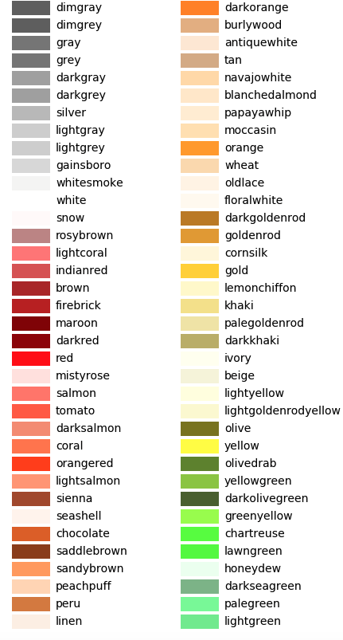
midnightblue
lightgrey
peru
goldenrod
darkgreen
dodgerblue
sienna
silver

Slide 31
Our model builds upon previous efforts to capture the complexity of mixed bedrock-alluvial systems
Plucking = f(K, Q, S, alpha)
Abrasion = f(Q_s, beta, alpha)
Attrition = f(Q_s, beta)
Sedimentation = f(Q_s, attrition, plucking, qL)
Channel adjusts to flow and sediment characteristics
Sediment transport adheres to equilibrium channel theory
Mixed Channels
Bedrock is abraded by mobile sediment
Width is self-adjusted within fixed valley
Slope adjusted to incision and sediment transport
Erode bedrock over long timescales, episodically alluviated
Loss of bedload via grain attrition
Bedrock is plucked via stream power
Sediment cover modulates transport and erosion
Notes:
Bedload sediment transport in equilibrium channels
Channel width adjustment to flow and sediment characteristics
Abrasion of bedrock by mobile sediment
Plucking of sediment
Sediment cover effects
Loss of gravel-sized sediment via grain attrition

Slide 32
Observations
Endmember paradigm – bedrock rivers and alluvial rivers
Complex landscapes have spectrum
Evolving understanding of these behaviors
Need model that moves in the direction of capturing this complexity!
Types of erosion dominance plot
Transport vs erosion plot
If E = 0.0001 at steady state, this doesn’t necessarily mean Eb = 0.0001. Could be that some fraction of steady state E is sediment transport? E = Eb + Eh
Or compare, show that although Eh = 0 at steady state, alpha is still close to 1 – alpha = 0 means bed is totally covered
Maybe a plot showing Qs efficiency and Eb efficiency?
Rivers to compare – Fraser near winter park; south fork of Williams fork near leal; crystal creek near redstone; chalk creek near nathrop; piceance creek near white river, co; yampa near Maybell; Hayden; Milner

